Slide 1
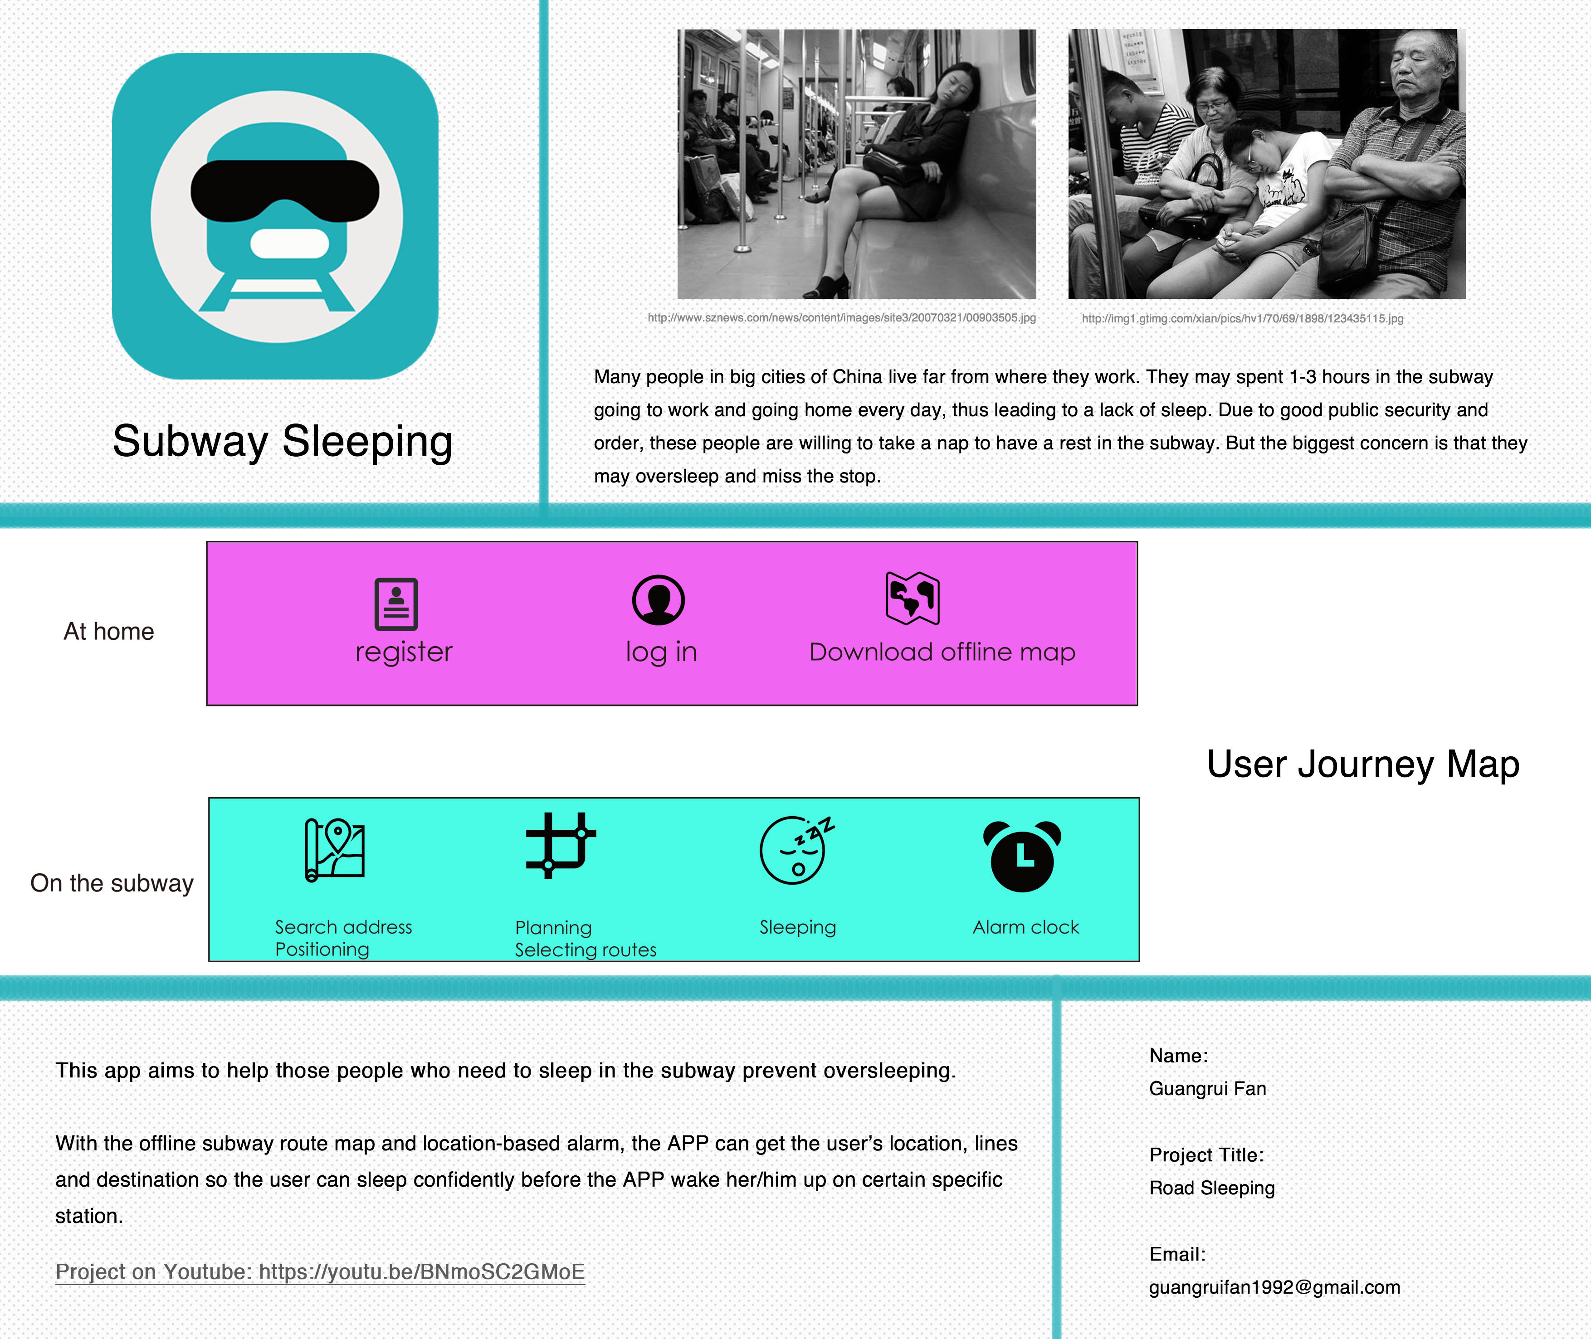

Slide 2
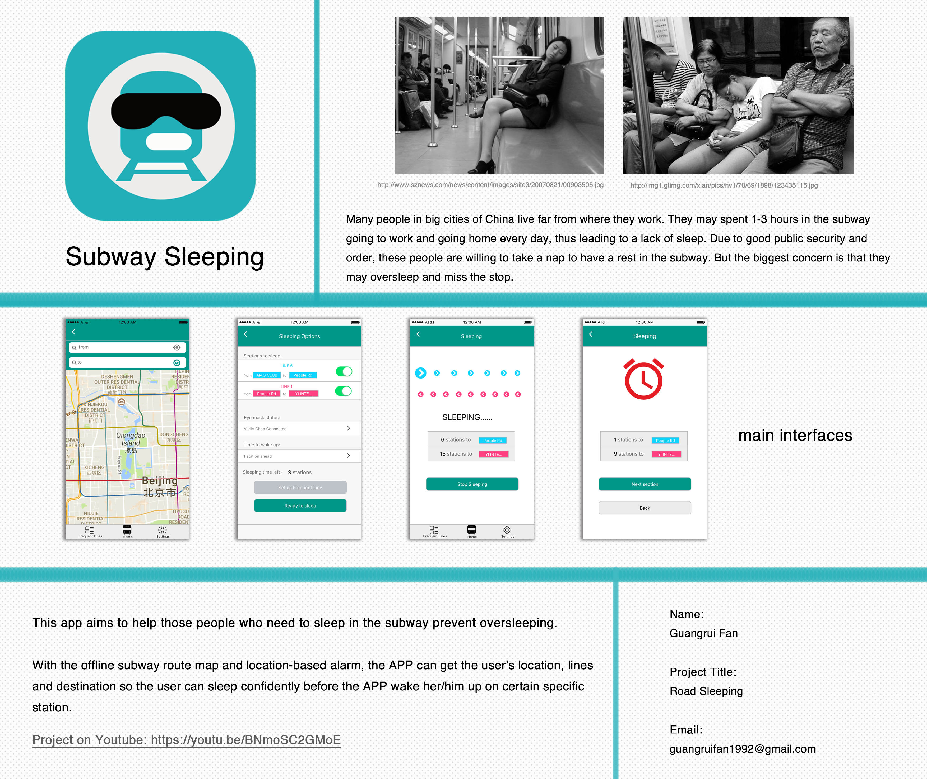

Slide 3
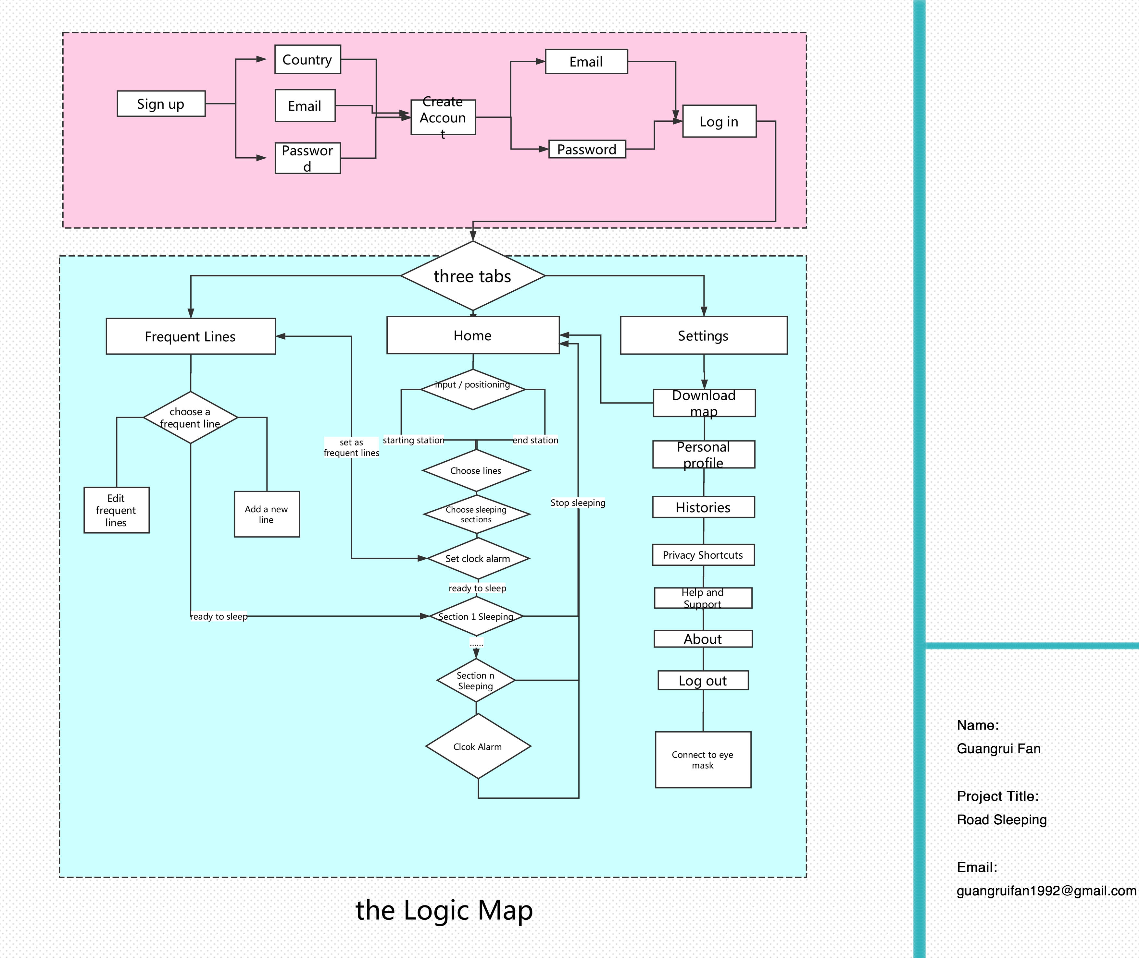

Slide 4
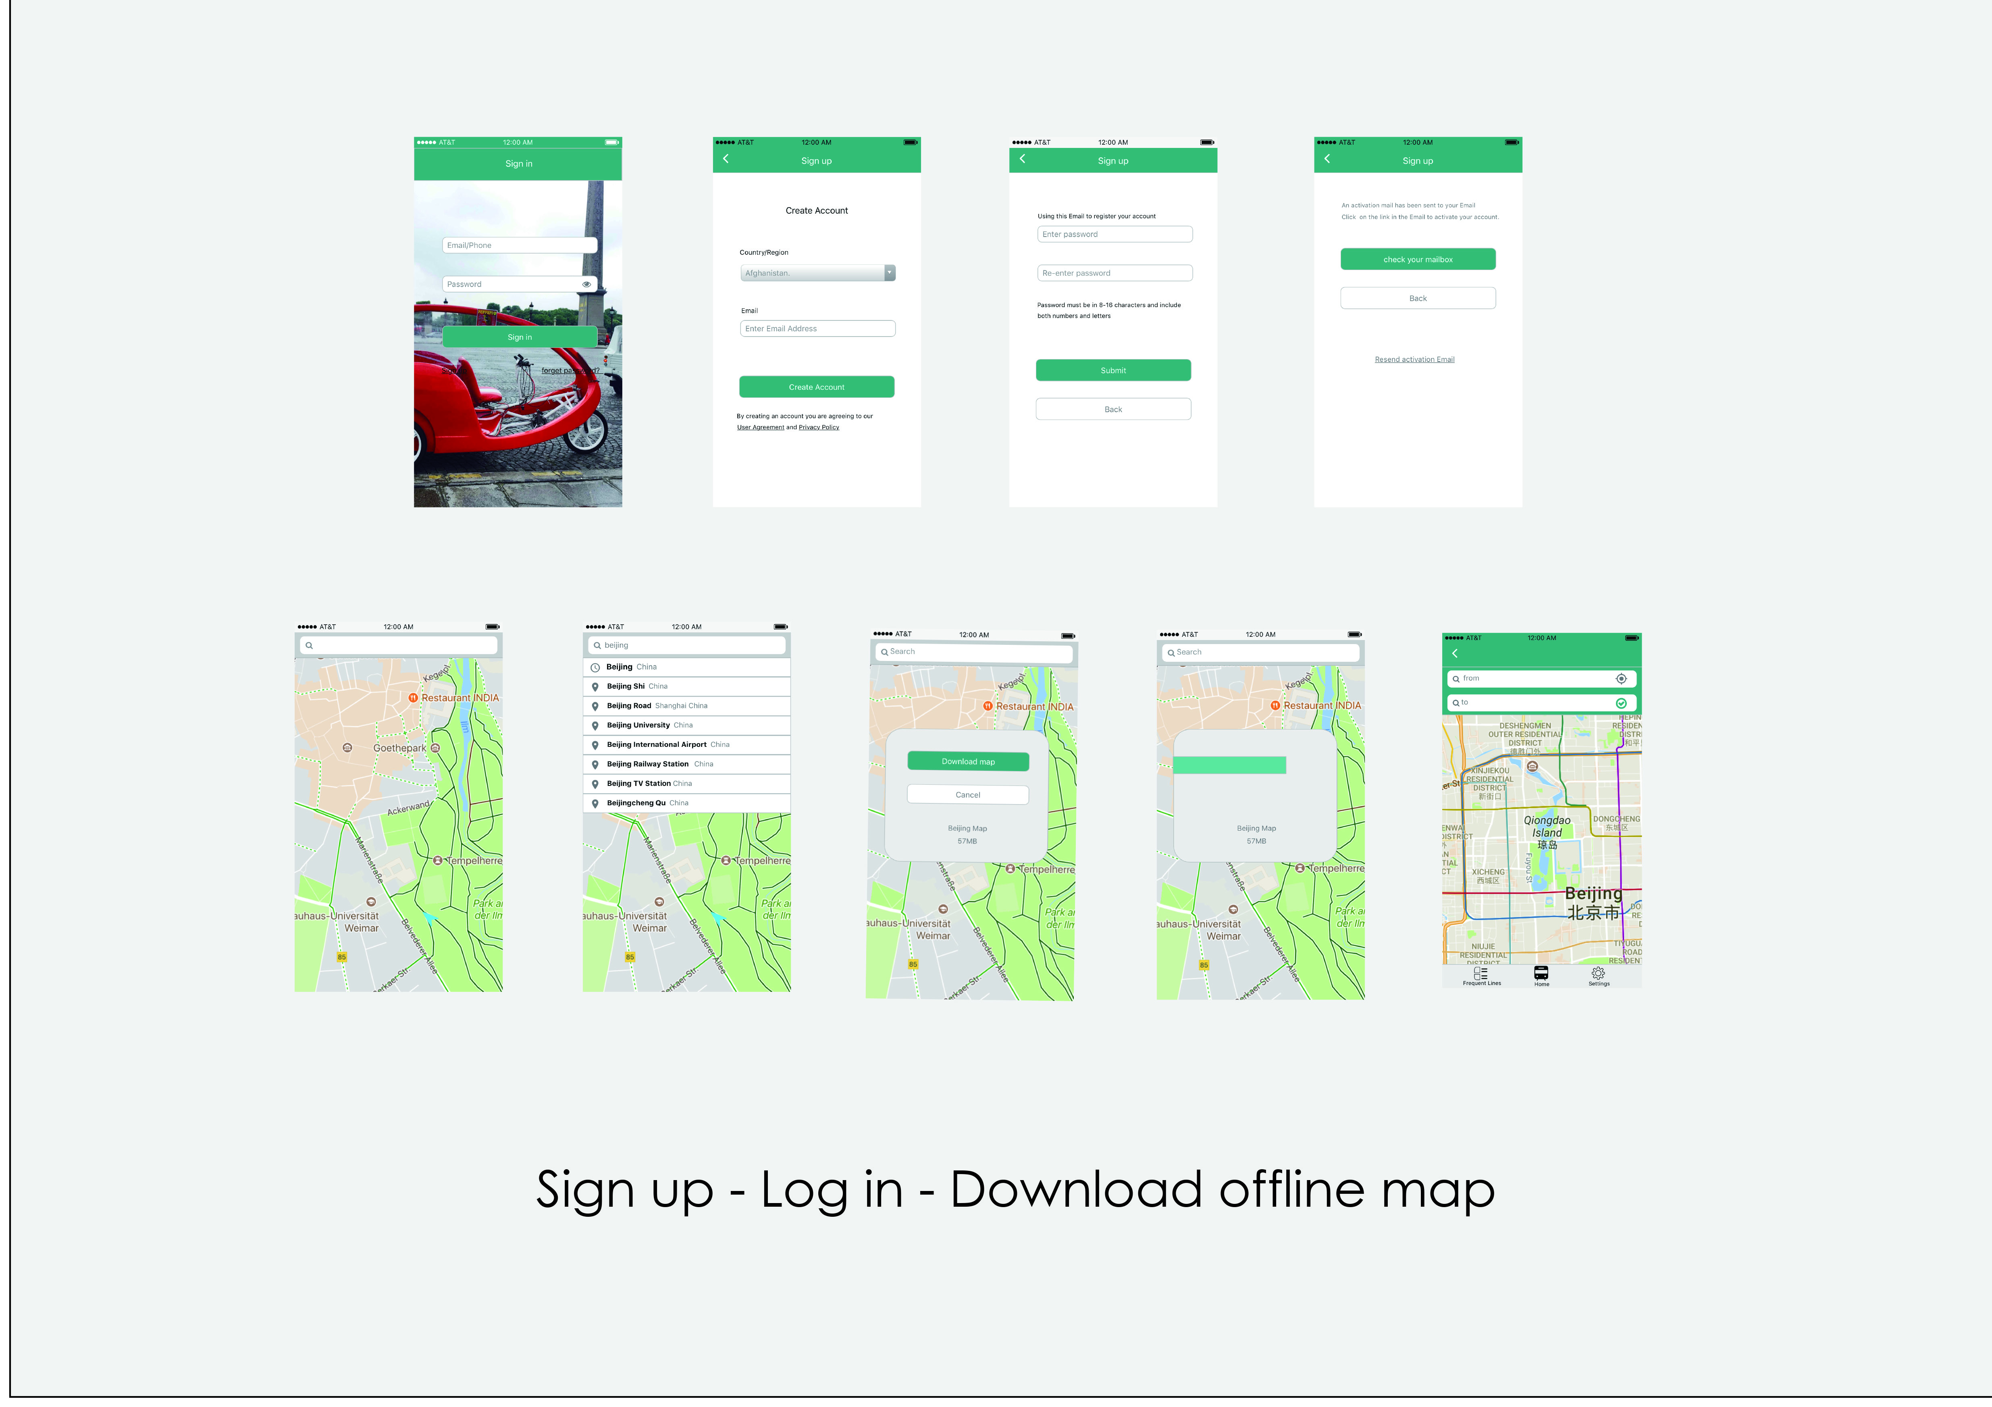

Slide 5
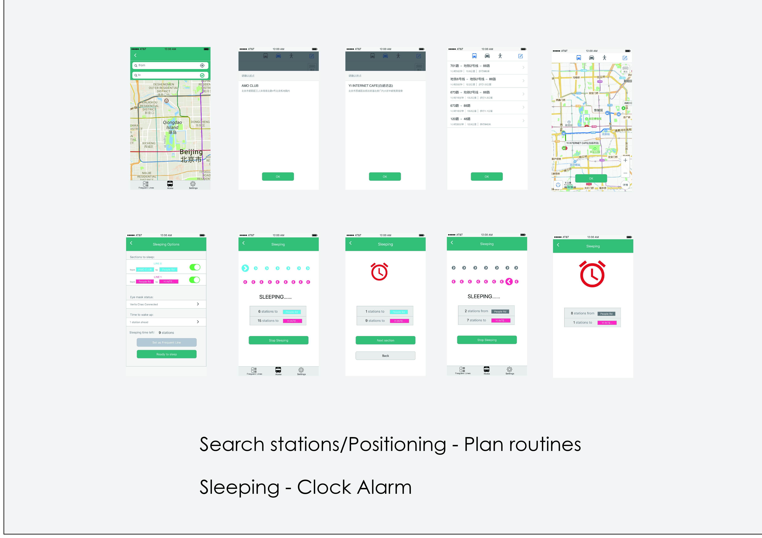

Slide 6
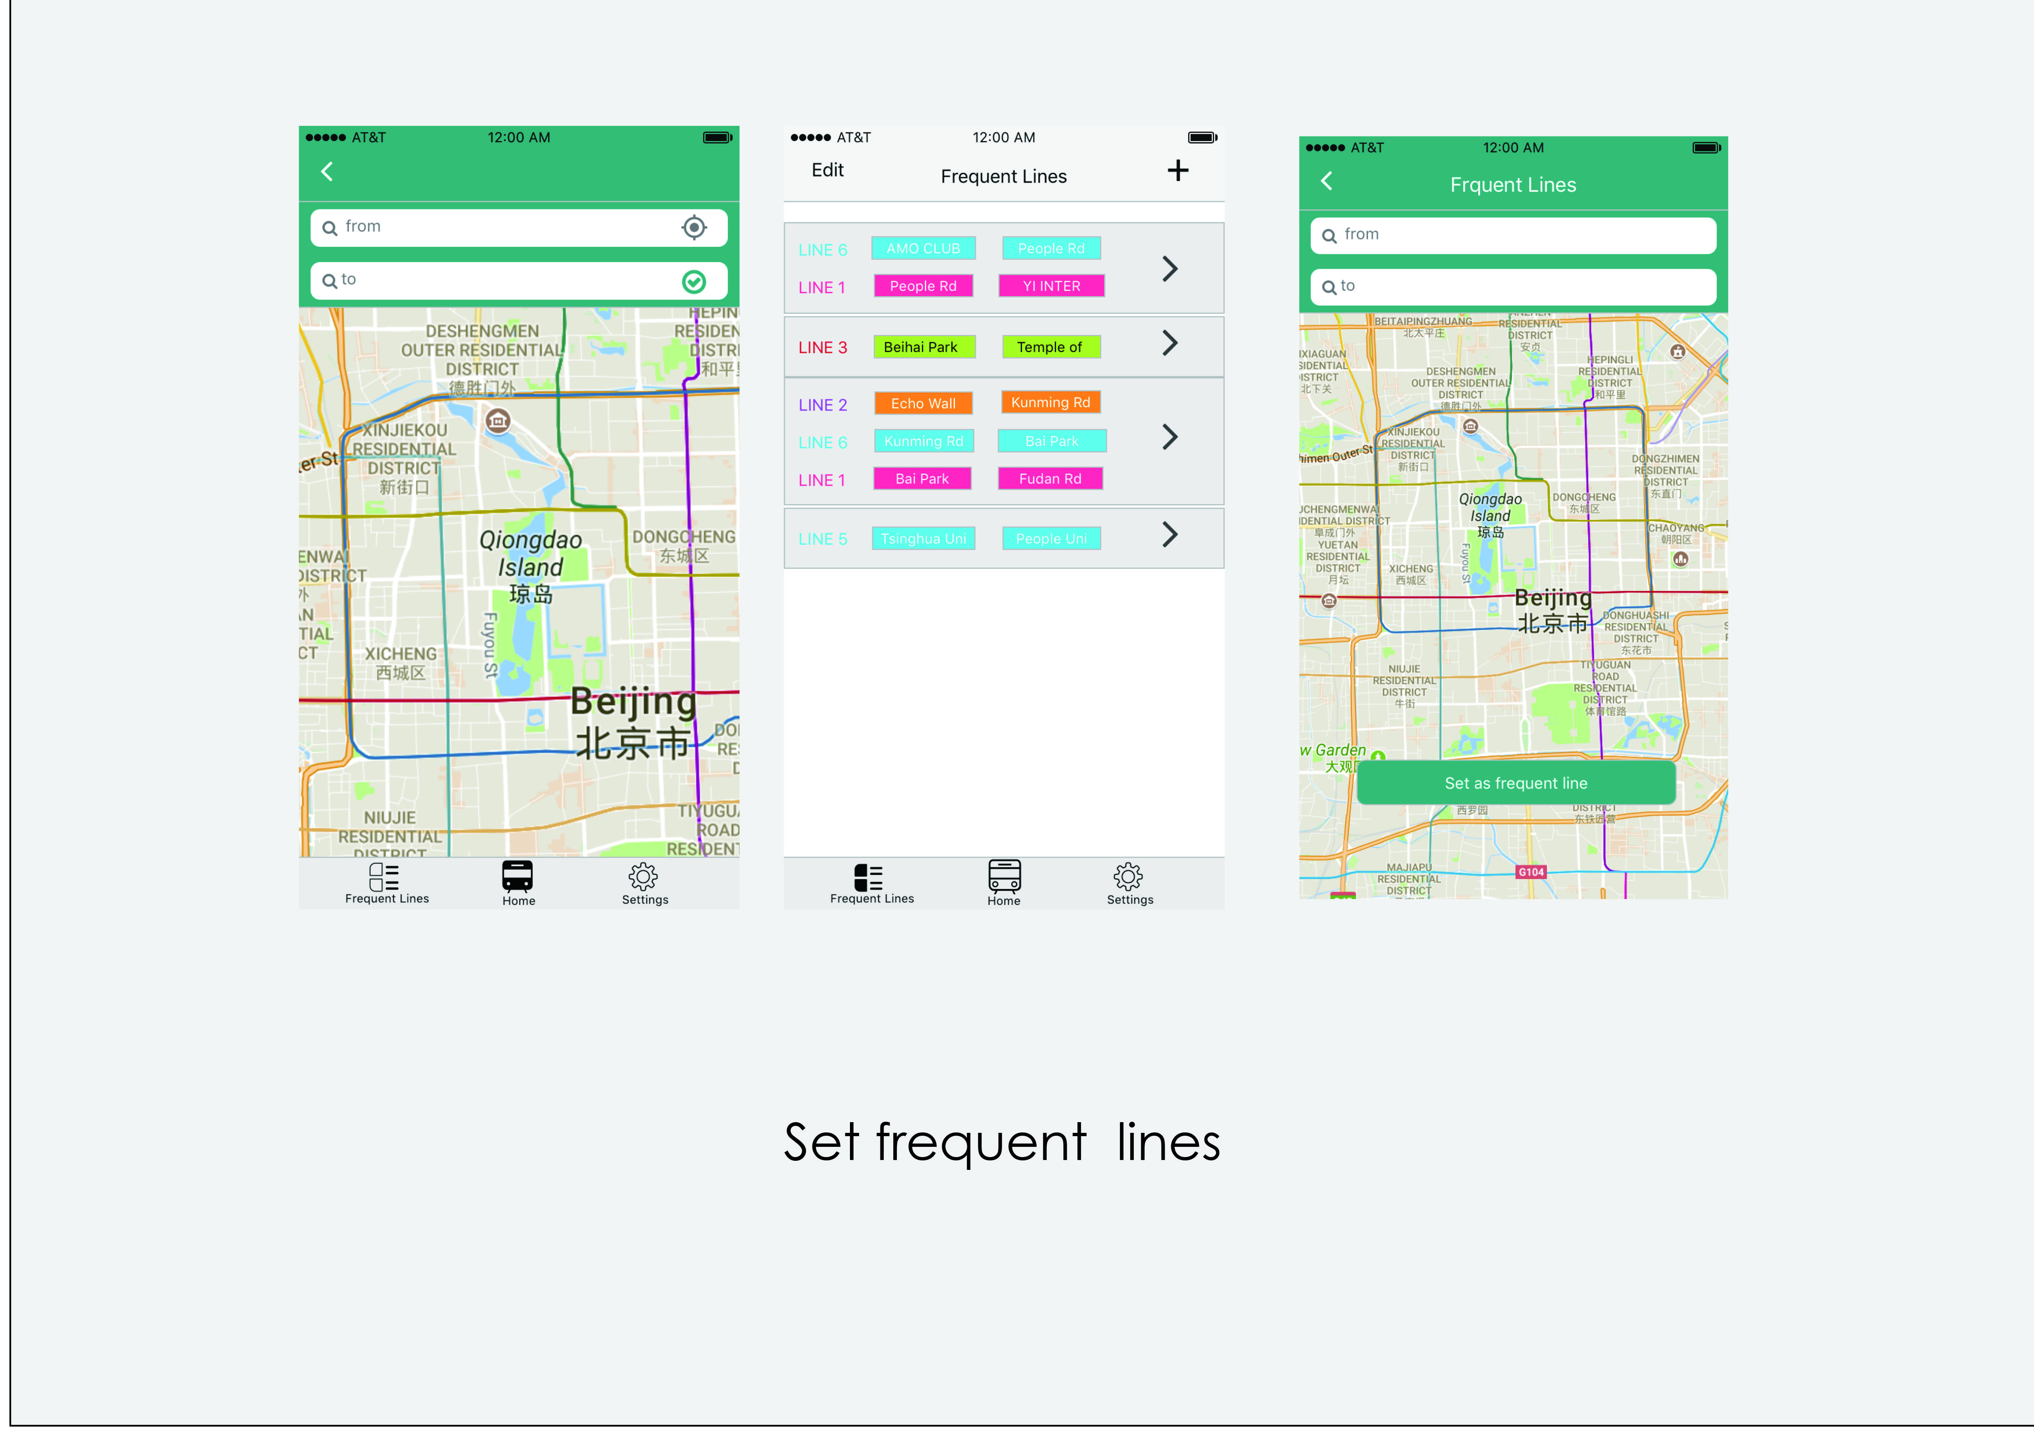

Slide 7
Prototype 1: Andriod apk file
Prototype 2: Html 5 file
Video Demo: https://youtu.be/BNmoSC2GMoE

Slide 8
