Slide 1
Psychology, art and dreams
Zhixuan Zhou
Shared Habitats

Slide 2
What is dream?

Slide 3
-What is dream?
1. why we have dreams
2. Smart Organizing System
https://www.ncbi.nlm.nih.gov/pmc/articles/PMC2869395/\
3. Dream control 《Inception》
4. Black and white? or with color?

Slide 4
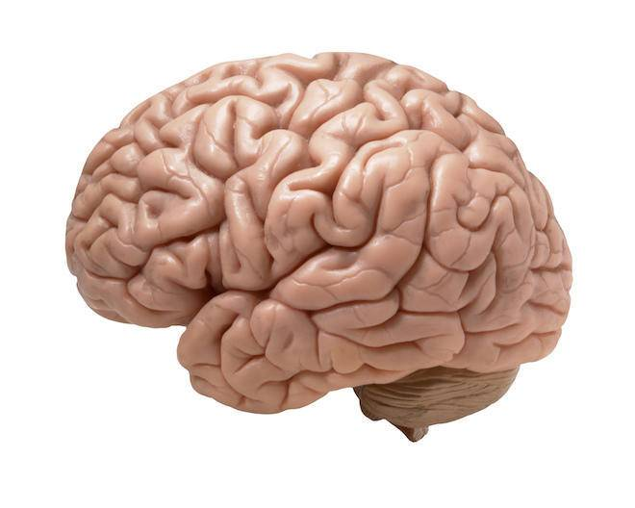
Sight
hearing
smell
taste
touch
Informations
dreams

Slide 5
What is the relationship between Dreams and Art?

Slide 6
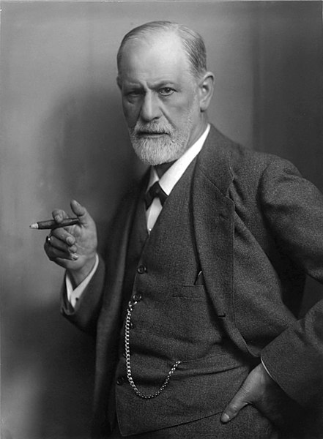

Dreams are the product of our desires
Sigmund Freud

Slide 7
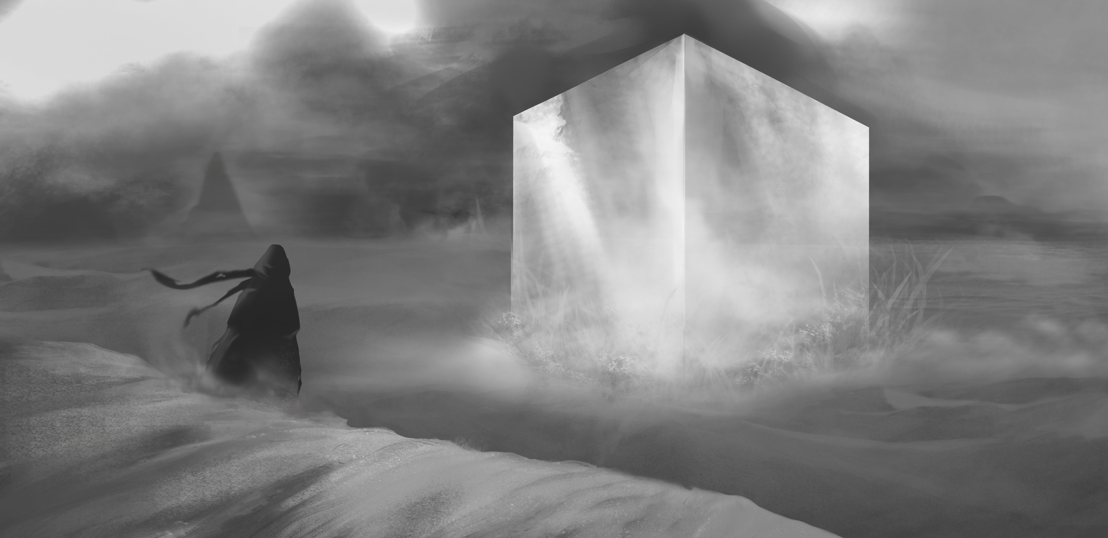
Franziska’s dream

Slide 8

one of my dream in 2016

