Slide 1
Printed Electronics, poems and typography
Jiani Qu
A project in Interface Design – Grundlagen and
Printed Electronics: Electronic Upcycling

Slide 2
The creative process
Capacitive sensing
Poems
Typography
Design and planning

Slide 3
The creative process | Printed electronics
The first idea: button pressed and images lights up
Elements: old canvas, acrylic paints, conductive ink, led, arduino, circuits and programming
Relatively easy, but too simple
https://www.sciencedaily.com/releases/2015/07/150729113850.htm

Slide 4
The creative process | Printed electronics
Plans change: dims the light and play some musik
Patterns/words painted with conductive ink serve as buttons
Press different words/patterns to play different songs
Even more advanced:
One-man acapella
Each buttons presents a part and can be played simultaneously
Another variant:
Artistic reading of poems
Play around with typography
Additional: volume control with capacitive sensing

Slide 5
Design and planning
The final idea:
3 30x30 canvases with conductive ink painted typography
Poems of freedom, human rights and surviving

Slide 6
Design and planning | Poems of Maya Angelou
“
You may write me down in history
With your bitter, twisted lies
You may tread me in the very dirt
But still, like dust, I’ll rise
”
Maya Angelou’s life had spanned much of the African American struggle for racial equality. She was was an American poet, memoirist, and civil rights activist.

Slide 7
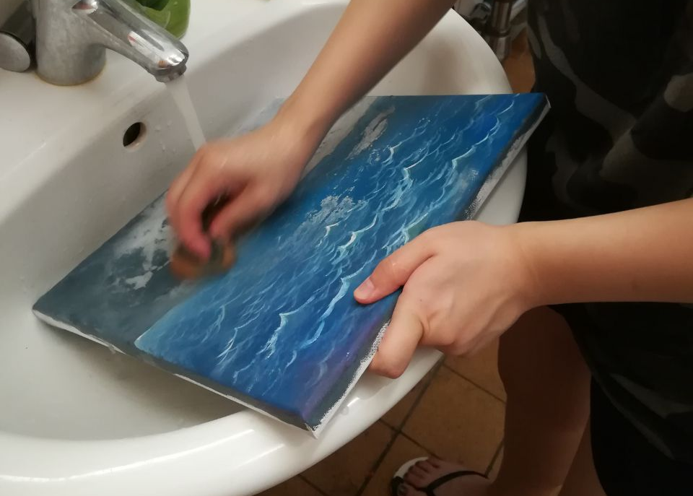
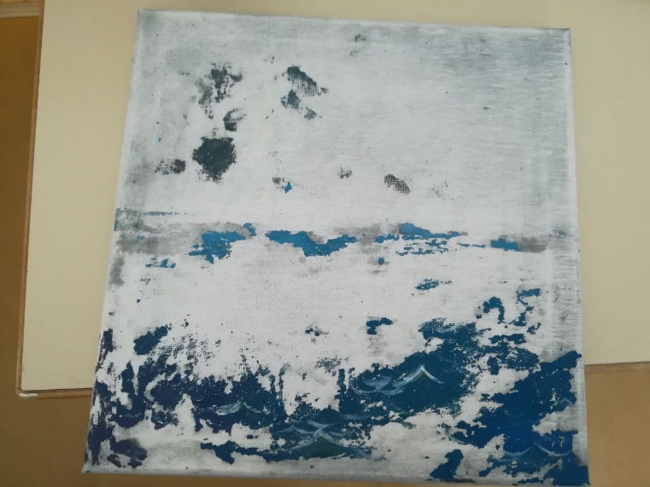
Design and planning | Upcycling

Slide 8
Design and planning | Circuits and capacitive sensing

Slide 9
Design and planning | Plans
Try out the quality of the different designs in regards of capacitive sensing
Record the poems in audio and design the sound so that if more poems played all at one, they will still be in harmony
Write program to make things work together

