Slide 3
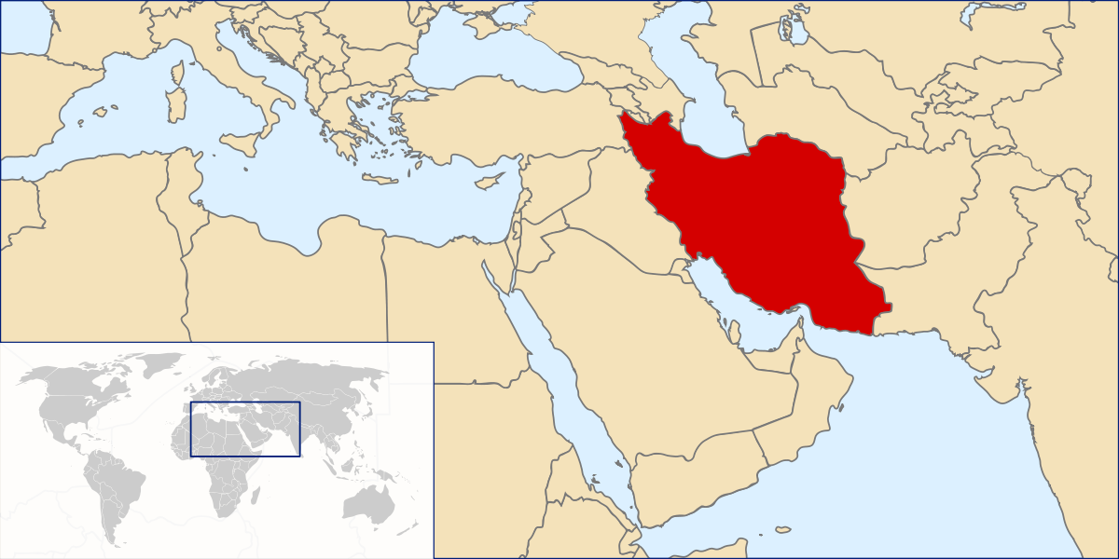
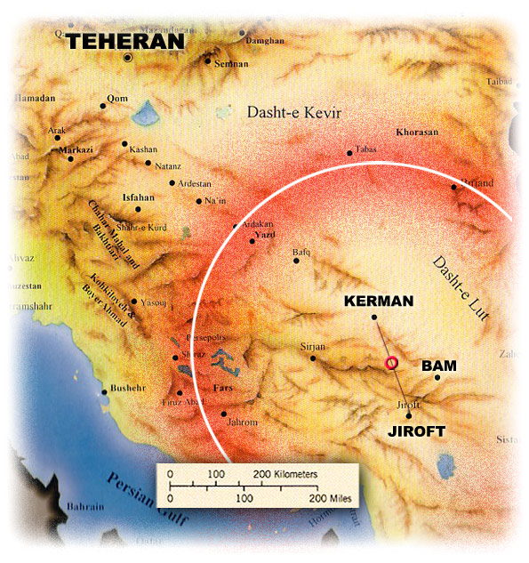

Slide 4
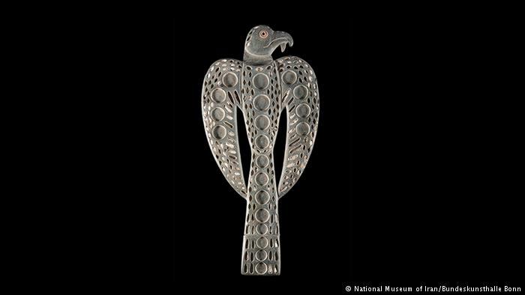
Jiroft culture
A "Jiroft culture" has been postulated as an early Bronze Age (late 3rd millennium BC) archaeological culture, located in the territory of the present day Sistan and Kermān Provinces of Iran. The hypothesis is based on a collection of artifacts that were confiscated in Iran and reported by the Iranian news services, beginning in 2001.
The proposed type site is Konar Sandal, near Jiroft in the Halil River area. Other significant sites associated with the culture include; Shahr-e Sukhteh (Burnt City), Tepe Bampur, Espiedej, Shahdad, Tal-i-Iblis and Tepe Yahya.
The Journey to the Middle East is an important part of the Yusef Majidzadeh, the chief of the archaeological excavation team in Jiroft , He is a man who is a man of the world. Other conjectures (for example, Daniel T. Potts, Piotr Steinkeller) have connected the Konar Sandal with the obscure city-state of Marhashi, that apparently lay to the east of Elam proper.

Slide 5
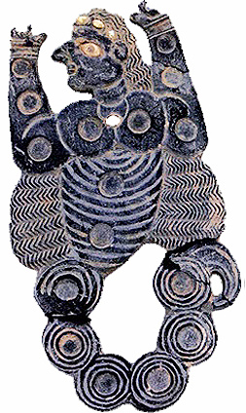
Jiroft, Halilrood area of ​​Kerman, indicating the people of the area enjoyed playing some five thousand years ago.
Three of these gameboards look like eagles, one looks like a scorpion with a human head, and the other is a flatboard, and all have 12 or 18 holes with similar sizes. The discovery site of the boards, Halilrood, is considered one of The richest archeological sites of the world where ancient archeologists and looters. More than 700 sites have been identified in a 400 kilometer long area of ​​the Halilrood River bank.
According to the archeology team of Jiroft, Yusef Majidzadeh, the holes in the boards, which count in the boards.
It is not yet sure how the boards have been used, Majidzadeh told CHN, however, the same numbers of the holes and the holes all in one size show.
Jean Perrot, a world-known archeologist and a retired expert of the Louvre Museum who has been studying the boards told by Mesopotamia, and their form and structure shows That ancient people used them as games to entertain themselves

Slide 6
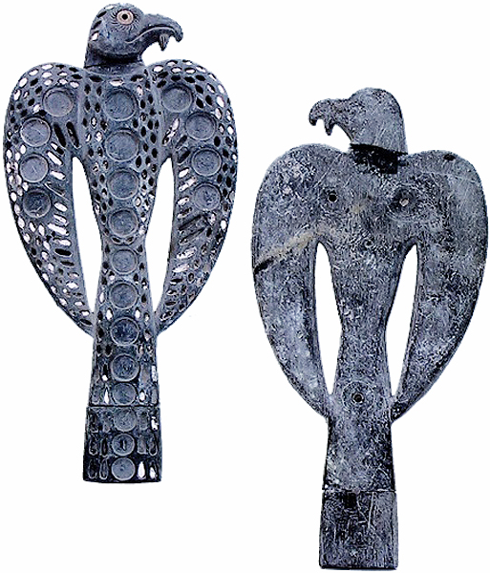
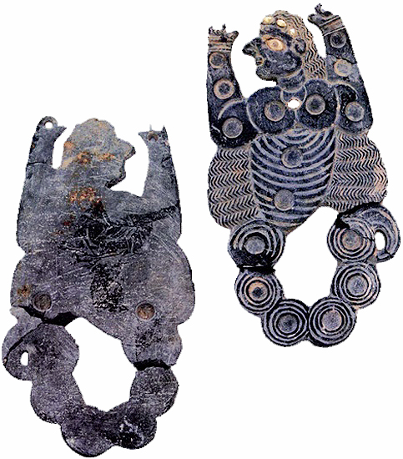

Slide 7
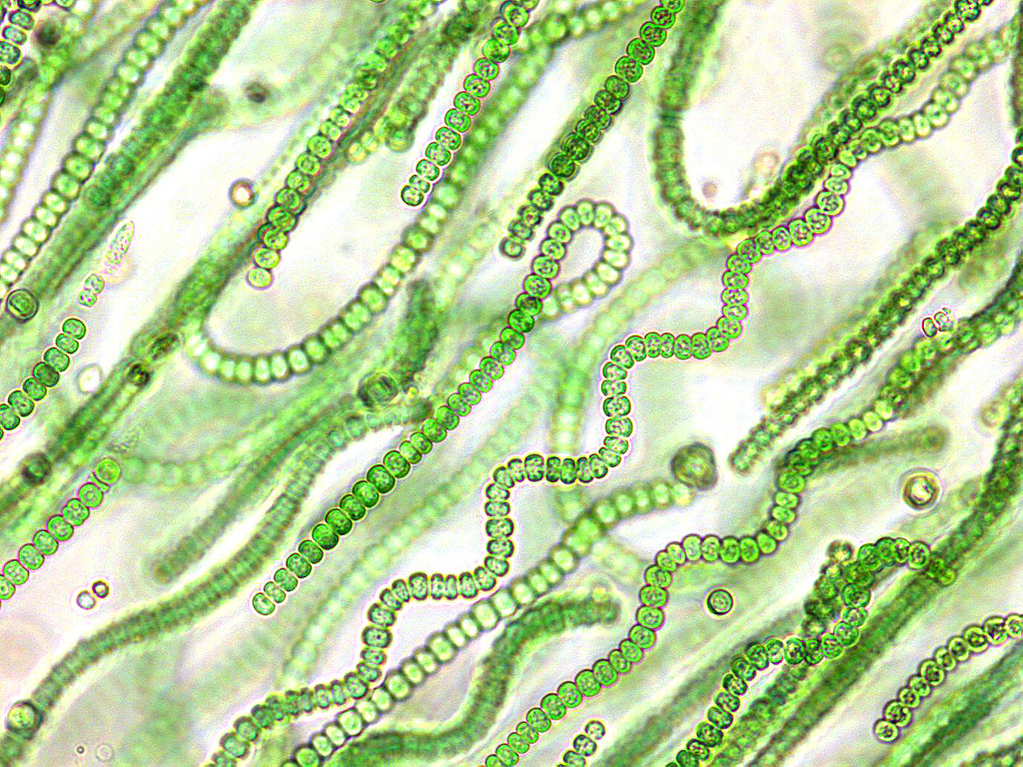
Blue-green bacteria
Cyanobacteria, also known as Cyanophyta, is a phylum of bacteria that is able to recognize their energy through photosynthesis, and are only photosynthetic prokaryotes able to produce oxygen. The name "cyanobacteria" comes from the color of the bacteria. Cyanobacteria contain only one form of chlorophyll, chlorophyll a, a green pigment. In addition, they contain various yellowish carotenoids, the blue pigment phycobilin, and, in some species, the red pigment phycoerythrin. The combination of phycobilin and chlorophyll produces the characteristic blue-green color from which these organisms derive their popular name. Because of the other pigments, however, many species are actually green, brown, yellow, black, or red.

