Slide 1
Performance Art
Dance Project
“Solo”
Helin Özdemir
122519
Media Art Strategies
WiSe 2020/21

Slide 2
Performance Art
Performance art is an artwork or art exhibition created through actions executed by the artist or other participants. It may be live, through documentation, spontaneously or written, presented to a public in a Fine Arts context, traditionally interdisciplinary. Also known as artistic action, it has been developed through the years as a genre of its own in which art is presented live. It had an important and fundamental role in 20th century avant garde art.

Slide 3
Performance Art
It involves four basic elements: time, space, body, and presence of the artist, and the relation between the creator and the public. The actions, generally developed in art galleries and museums, can take place in the street, any kind of setting or space and during any time period. It’s goal is to generate a reaction, sometimes with the support of improvisation and a sense of aesthetics. The themes are commonly linked to life experiences of the artist themselves, or the need of denunciation or social criticism and with a spirit of transformation.

Slide 4
Performance Art
Performance art is a form of expression that was born as an alternative artistic manifestation. The discipline emerged in 1916 parallel to dadaism, under the umbrella of conceptual art. The movement was led by Tristan Tzara, one of the pioneers of Dada. Western culture theorists have set the origins of performance art in the beginnings of the 20th century, along with constructivism, Futurism and Dadaism. Dada was an important inspiration because of their poetry actions, which drifted apart from conventionalisms, and futurist artists, specially some members of Russian futurism, could also be identified as part of the starting process of performance art.

Slide 5
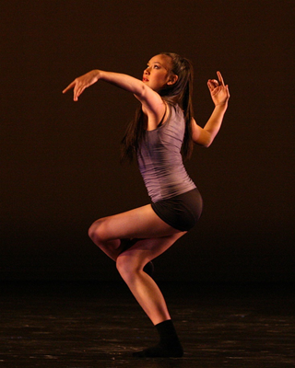
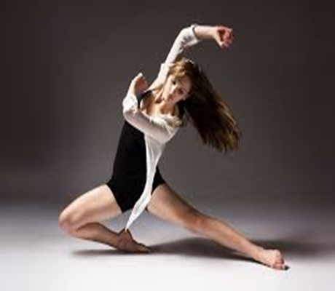
Dance Performance
Contemporary Dance

Slide 6
Dance Performance
Jazz Dance
Jazz dance is a performance dance technique and style that first emerged in the United States in the early twentieth century. Jazz dance may refer to vernacular jazz or to Broadway or theatrical jazz. Both genres build on African-American vernacular styles of dancing that emerged with jazz music. Vernacular jazz dance includes ragtime dances, Charleston, Lindy hop, and mambo. Popular vernacular jazz dance performers include The Whitman Sisters, Florence Mills, Ethel Waters, Al & Leon, Frankie Manning, Norma Miller, Dawn Hampton, and Katherine Dunham. Theatrical jazz dance performed on the concert stage was popularized by Jack Cole, Bob Fosse, Eugene Louis Faccuito, and Gus Giordano.

Slide 7
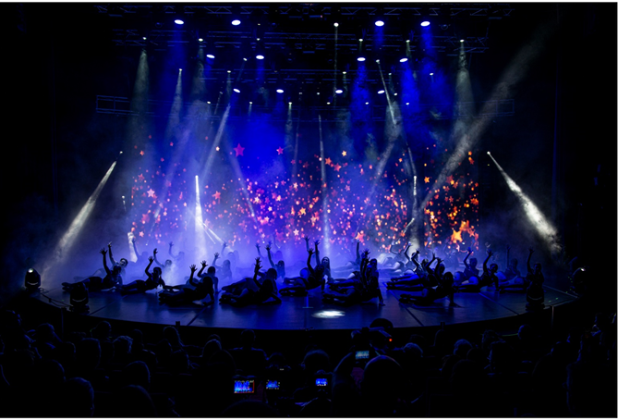
Dance Performance

Slide 8
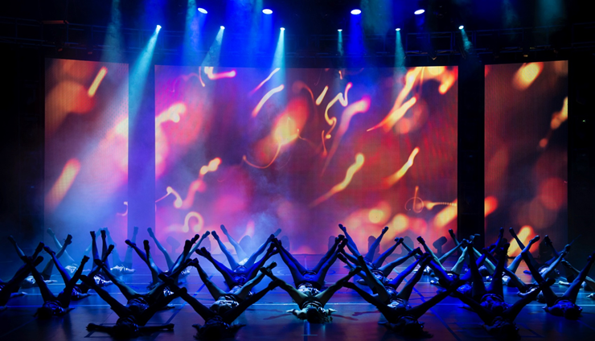
Dance Performance
Jazz Dance

Slide 9
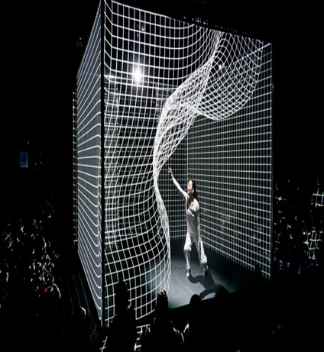
Digital Performance
Digital Performance is a very wide category filled with a range of productions. It is performance that incorporates and integrates computer technologies and techniques. Performers can incorporate multimedia into any type of production whether it is live on a theatre stage or in the street. Anything as small as video recordings or a visual image classifies the production as multimedia. When the key role in a performance is the technologies, it is considered a digital performance. This can be as little as projections on a screen in front of a live audience to creating and devising a performance in an online environment to using animation and sensing software’s.
Image from the Adrien M / Claire B Company performance “Hakanaï” © Romain Etienne / Item

Slide 10
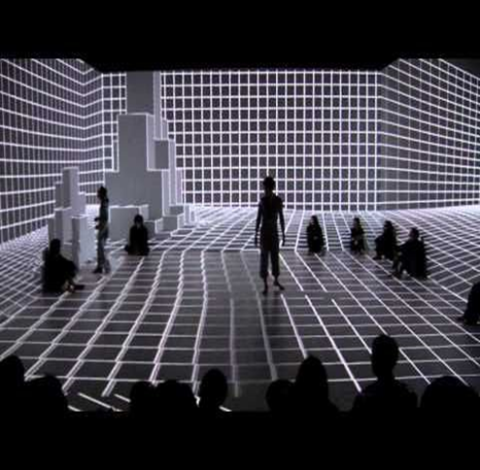
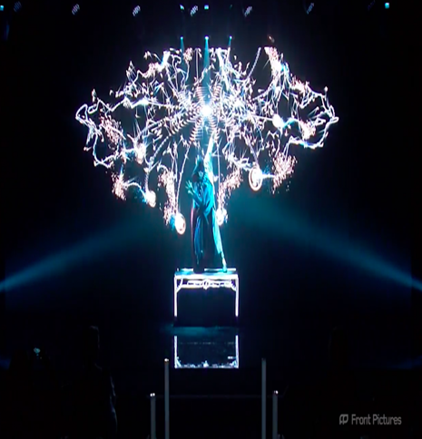
Digital Performance

Slide 11
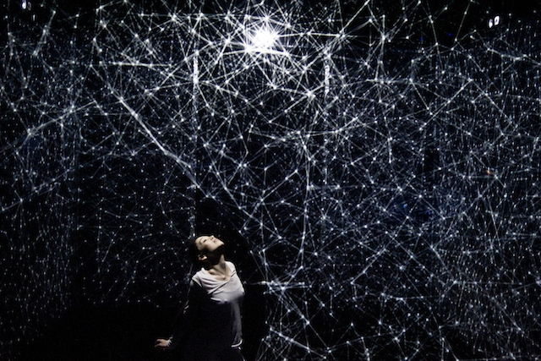
Technology Meets Dance
DANCER BENDS LIGHT IN STUNNING PROJECTION-MAPPED PERFORMANCE
A dancer takes a visual journey into a 3D space between dreams and reality inside a cube, interacting with the 3D projection art. Technology meets art in this stunning piece of performance.
Hakanaï, a digital solo performance from Adrien M / Claire B

Slide 12
Technology Meets Dance
DANCER BENDS LIGHT IN STUNNING PROJECTION-MAPPED PERFORMANCE
The performance symbolises the union of two Japanese characters—one meaning “man” and the other “dream”—used to define the ephemeral and the fragile.
In this environment, a dancer moves within the cube, interacting with the images projected on its walls, tracing arcing parabolas and sine waves with hands, arms, and feet.
The choreographed performance installation combines video projection mapping, CGI, and sensors, dynamically responding to the movements and proximity of the performer.
The visuals and how the dancer interacts mean that with each given performance, a unique performance is the result. Performer meets programming and the interactivity of the space.

Slide 13
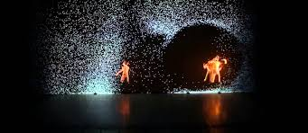
Technology Meets Dance
DANCER BENDS LIGHT IN STUNNING PROJECTION-MAPPED PERFORMANCE
This creative piece of innovative dance performance from Mondot and Bardainne, is inspired from mathematical sources, reflecting the world around them.
The gap between technology, performance and art seem to be blending with the like of this sort of innovative and mesmerising performance.

Slide 14
Performance Art
Some featured and inspired artists
•Trisha Brown
•Lucinda Childs
•Klaus Obermaier
•Daniel Belton

Slide 15
Performance Art
Some featured and inspired artists
Trisha Brown
Choreographer Trisha Brown was an integral figure of the American postmodern dance movement, and the influence of her works still prevails today. She bridged the worlds of art and dance, collaborating both with renowned choreographer Mikhael Baryshnikov for the Paris Opera Ballet, as well as with visual artists Robert Rauschenberg, Donald Judd, and Nancy Graves. Brownmoved to New York City in 1961, when she joined the avante-garde Judson Dance Group. She dismantled academia and musicality from her work, inspired by John Cage's radical changes to music.

Slide 16
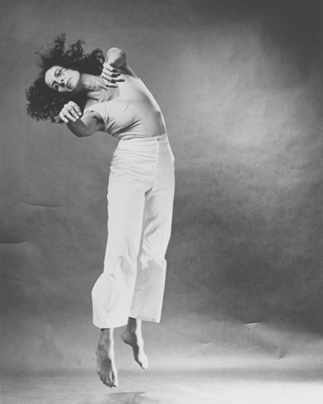
Performance Art
Some featured and inspired artists
Trisha Brown
In 1970 she founded the Grand Union, and then the Trisha Brown Dance Company. She made radical gestures in response to the history of dance, and practiced in unconventional spaces without any music. Her style was often referred to as "release technique." Her later works, beginning in the '80s, incorporated a more aesthetic element, as in Set and Resent, Newark, and Astral Convertible. Her work continually challenged the norms of dance, and made an event out of simple, ritual actions.

Slide 17
Performance Art
Trisha Brown video(s)
https://www.youtube.com/watch?v=3FALHd5Viz4&t=3s
https://www.youtube.com/watch?v=86I6icDKH3M&t=185s

Slide 18
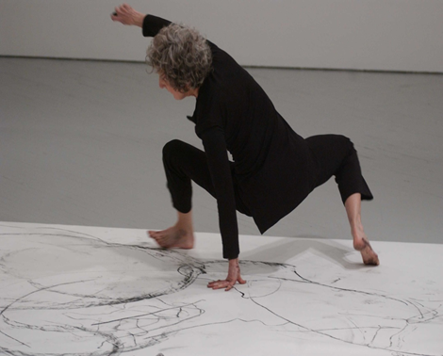
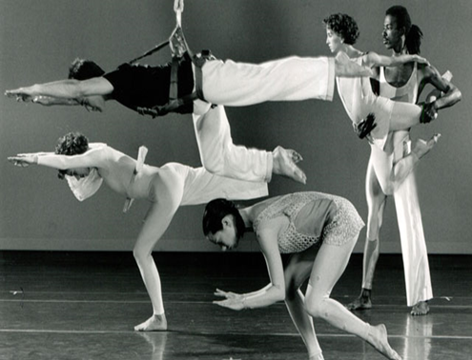
Performance Art
Some featured and inspired artists

Slide 19
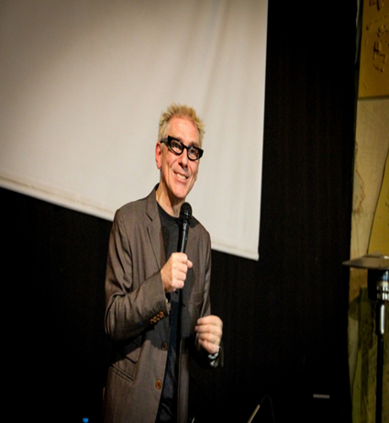
Performance Art
Some featured and inspired artists
Klaus Obermaier
Since more than two decades media-artist, director, choreographer and composer Klaus Obermaier creates innovative works with new media in performing arts, music and installations, highly acclaimed by critics and audience.
His inter-media performances and artworks are shown at festivals and theaters throughout Europe, Asia, North and South America and Australia.
Many of his projects, such as D.A.V.E, APPARITION, LE SACRE DU PRINTEMPS, DANCING HOUSE or EGO, are considered groundbreaking and genre-defining for the development of new artistic forms of human interaction with digital systems.

Slide 20
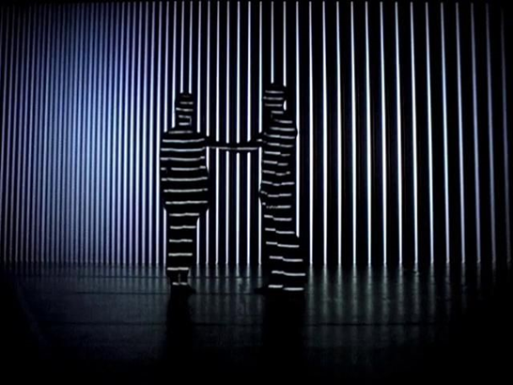
Performance Art
Some featured and inspired artists
Klaus Obermaier

Slide 21
Performance Art
Klaus Obermaier video(s)
https://www.youtube.com/watch?v=-wVq41Bi2yE&t=10s
https://www.youtube.com/watch?v=DhPtrpSIHXU&t=34s

Slide 22

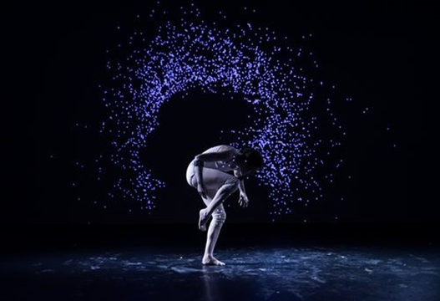
Media Art and Dance
The main purpose of the realization of this project is what kind of harmony is achieved between media art and performing arts. Especially in the field of dance, the use of media art in the stage platform is increasing today. Technological tools of media art stand out in the background and on the stage.

Slide 23
About the Project “Solo”
The project will be a dance performance and will be supported using media art tools.
Thema : Dance and Isolation
«Dance and Isolation»
Different reactions and moods of the body in the self-isolation process.

Slide 24
About the Project “Solo”
Stage
The project will be exhibited on the stage and presented to the audience in digital environment. Depending on the course of the coming days, changes may occur in the stage environment.
Time
The performance will take around 5 -10 minutes .

Slide 25
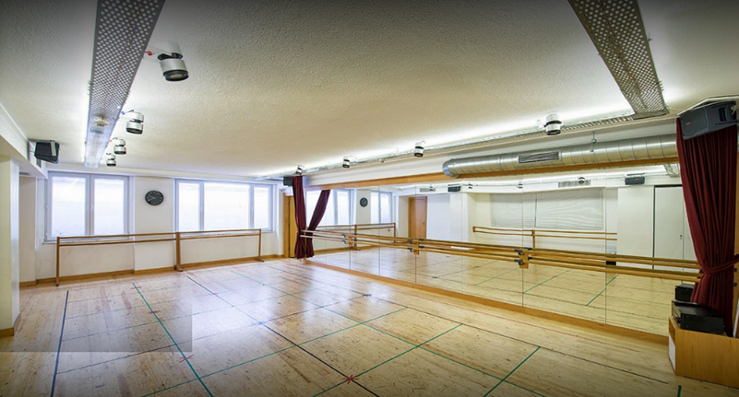
About the Project “Solo”
Place (Working Area/Studio)

Slide 26

Project Video (For some trials)

Slide 27
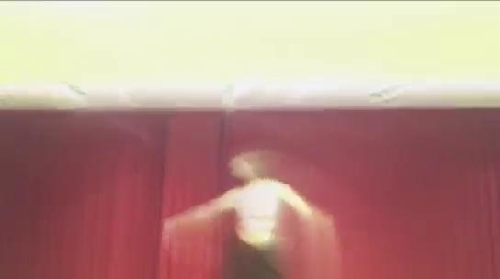
Project Video (For some trials)

Slide 28
The programs worked on for the project
After Effects
Wave Video
Blender
Motion
Filmora

Slide 29
REFERENCES
https://en.wikipedia.org/wiki/Performance_art
https://en.wikipedia.org/wiki/Contemporary_dance
https://en.wikipedia.org/wiki/Jazz_dance
https://en.wikipedia.org/wiki/Digital_performance
https://www.uni-weimar.de/kunst-und-gestaltung/wiki/GMU:Performance_Platform
https://futureearth.com.au/technology-meets-dance/
https://www.youtube.com/watch?v=3FALHd5Viz4
https://www.youtube.com/watch?v=-wVq41Bi2yE&t=398s
https://www.dw.com/en/performance-art-pioneer-ulay-marina-abramovics-former-partner-has-died/a-52612127

