Slide 1
Overview of Relevant Artworks/Practice
Lilas Almalla
Patterns, 2026

Slide 2

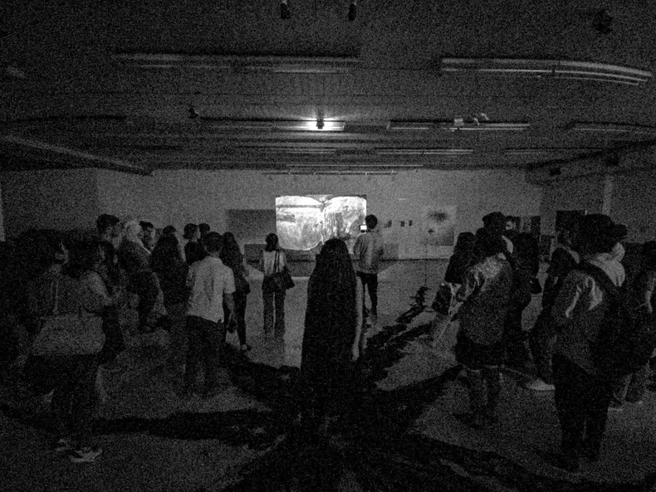
Lilith
Performance installation 9 paintings
2 voice performers
Hair-like material
Light fixture
Light controlling device
Photo credit: Aissar Abu Fakhr

Slide 3
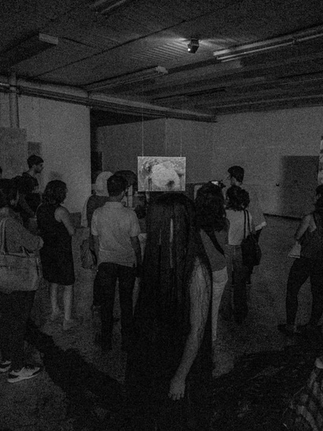
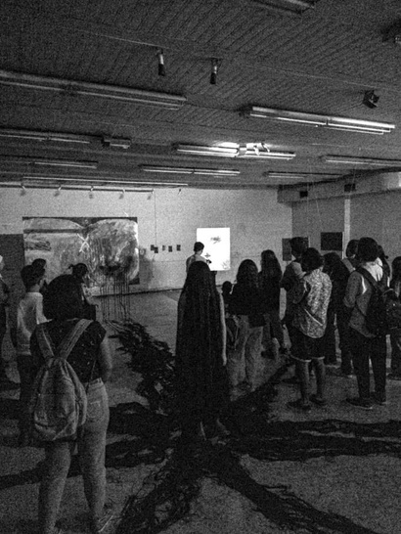
Photo credit: Aissar Abu Fakhr

Slide 4
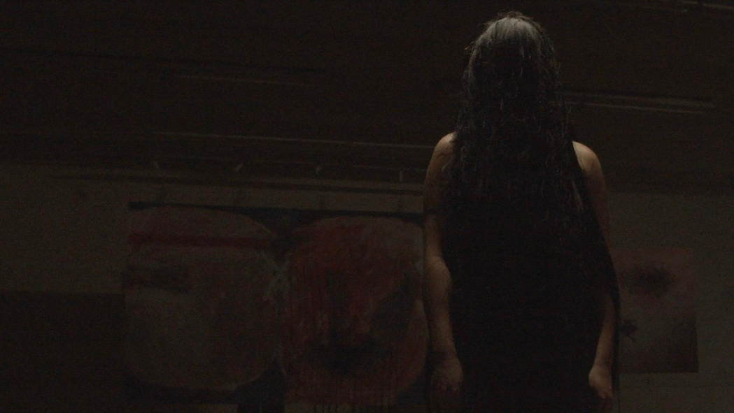
Photo credit: Hamza Abzakh, voice performer Taima Harb

Slide 5
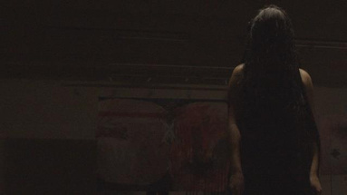
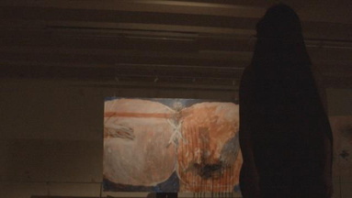
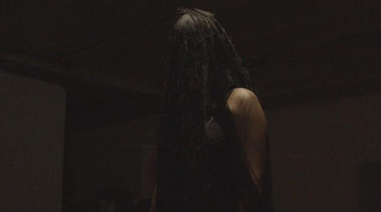
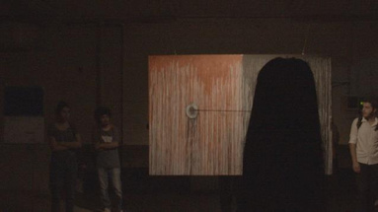
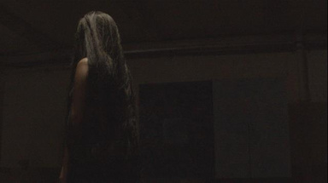
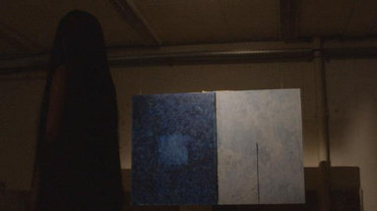
Photo credit: Hamza Abzakh, voice performer Taima Harb

Slide 6
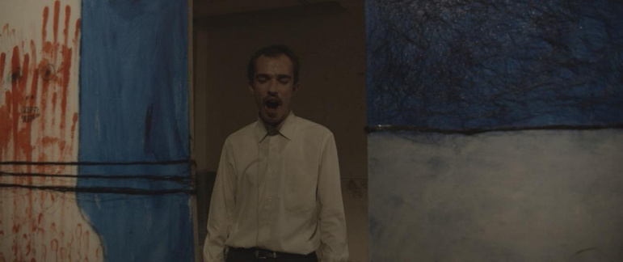
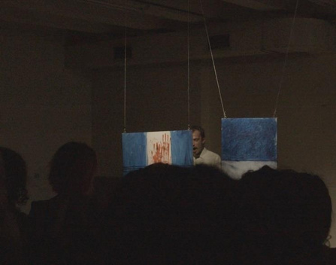
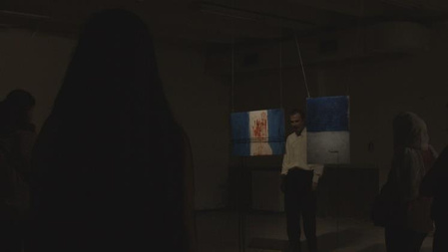
Photo credit: Hamza Abzakh, voice performer RasoolAwari

Slide 7

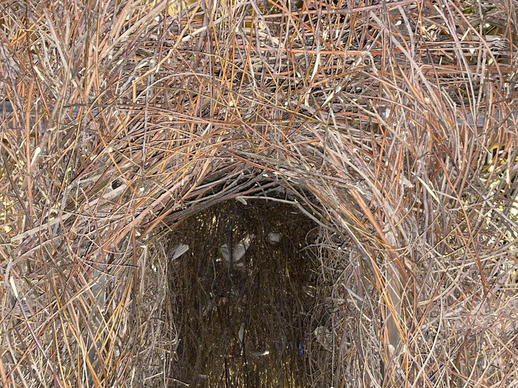
Home
Sound installation Tree branches
Iron structure
Burlap threads
30 resin pigeons
20 lighting devices
Sound system

Slide 8
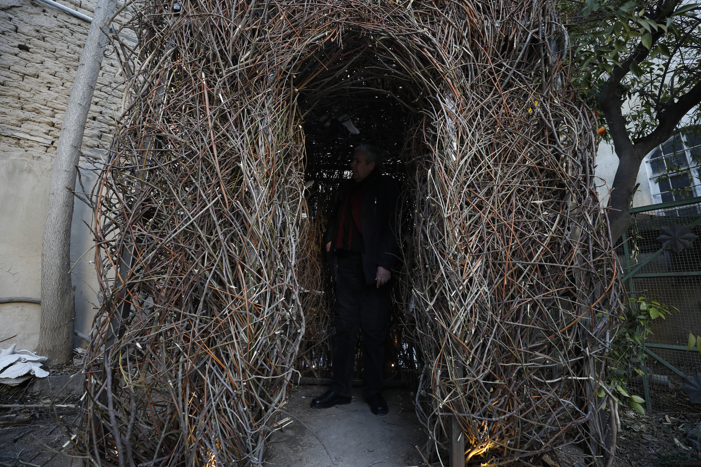

Slide 9
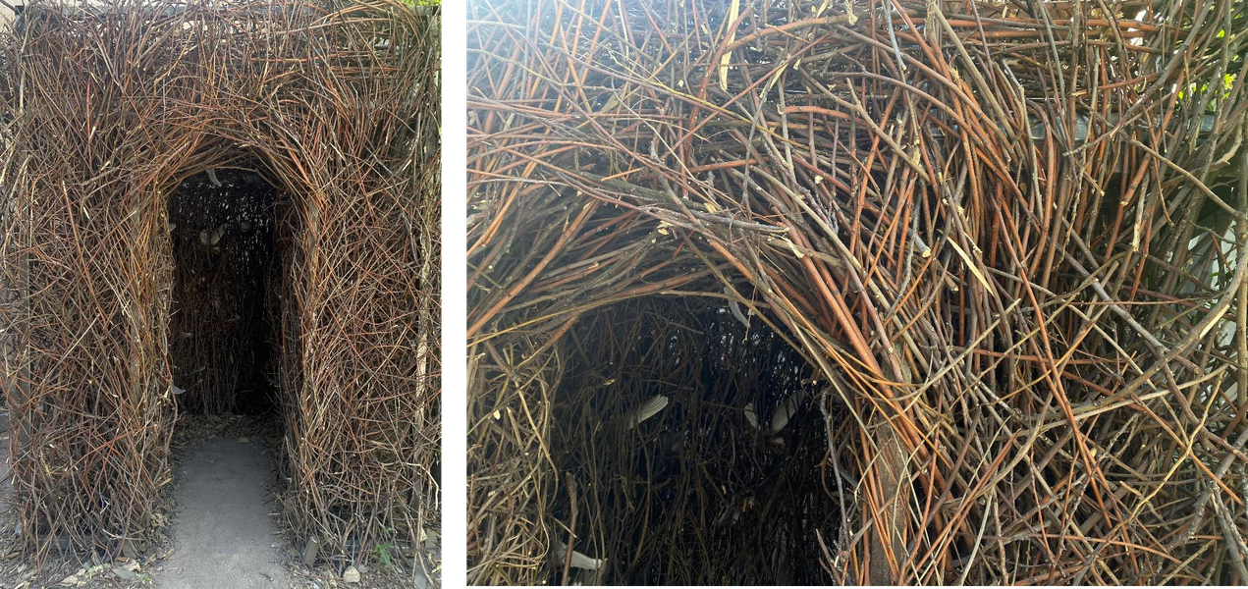
‘Home’ in day light.

Slide 10
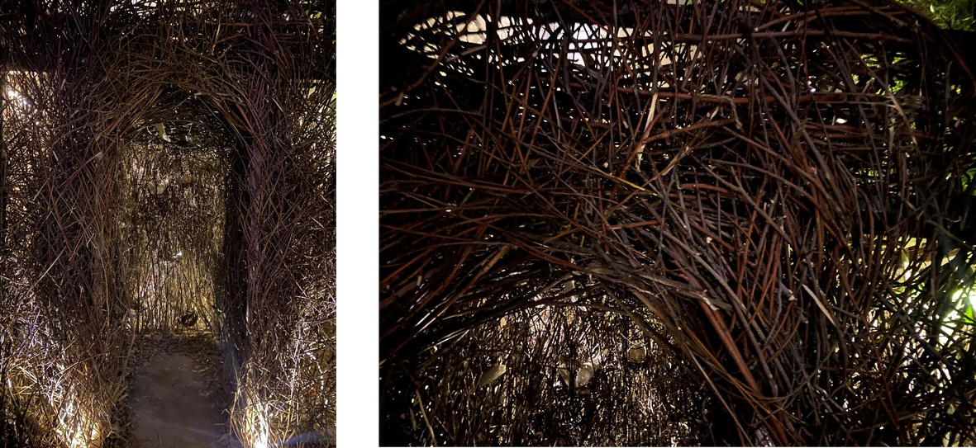
‘Home’ after the sun sets.

Slide 11
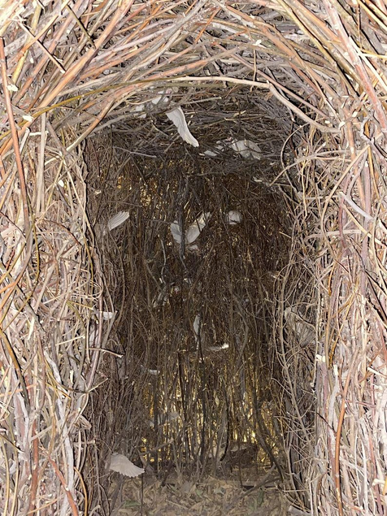
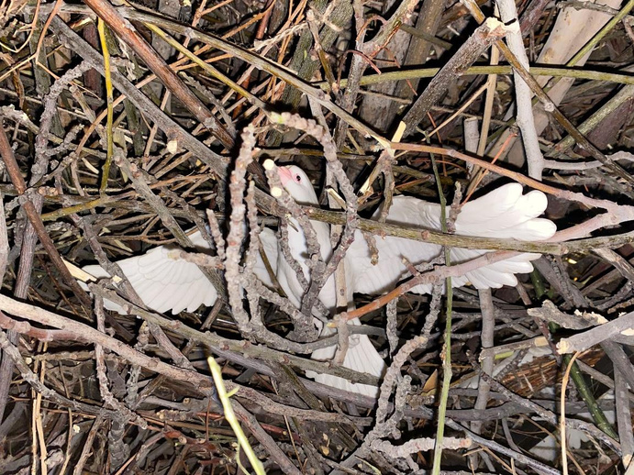
Details of ‘Home’.

Slide 12
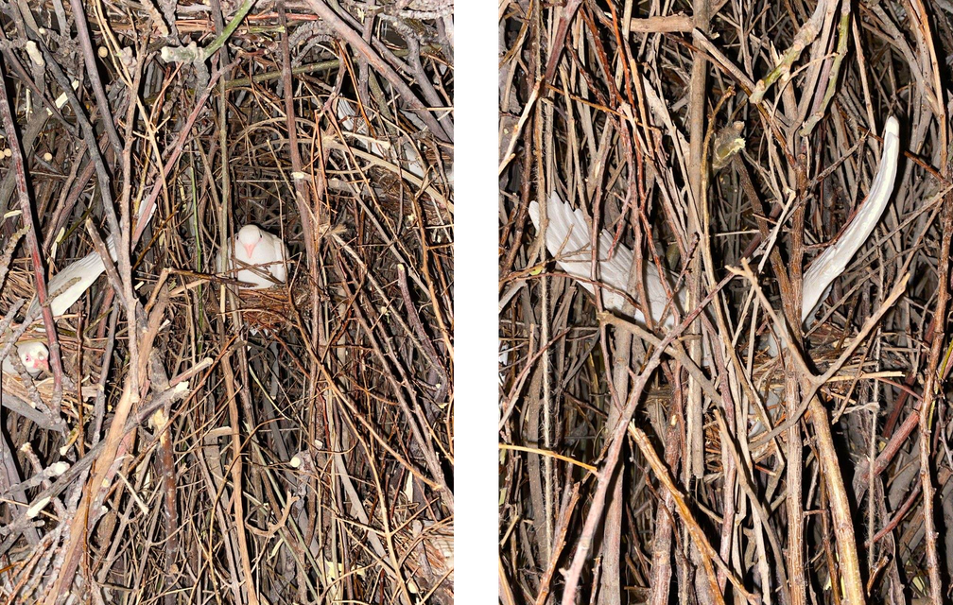

Slide 13
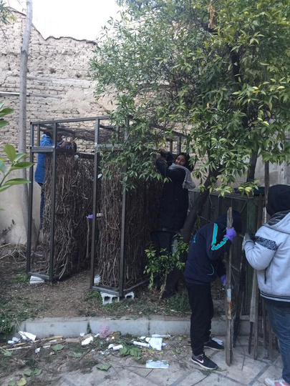
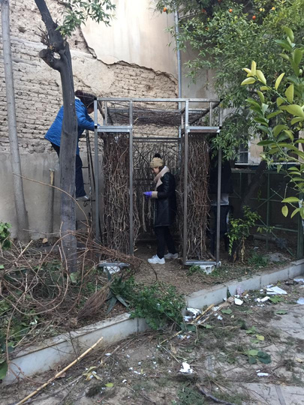
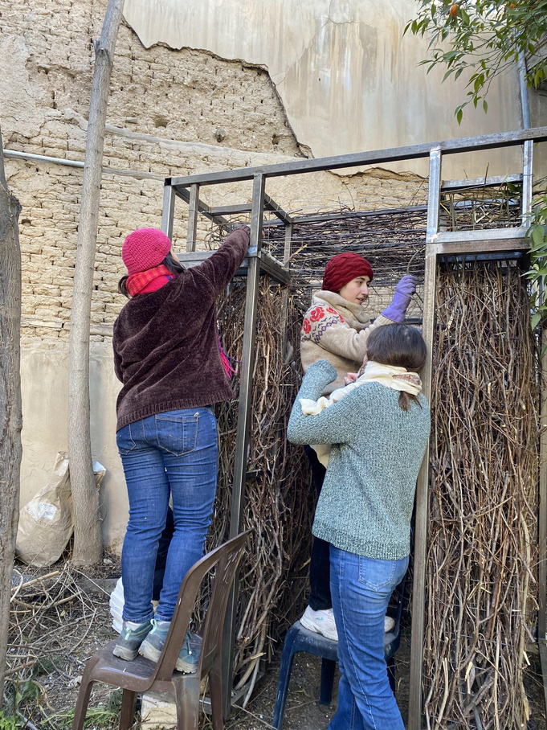

Slide 14
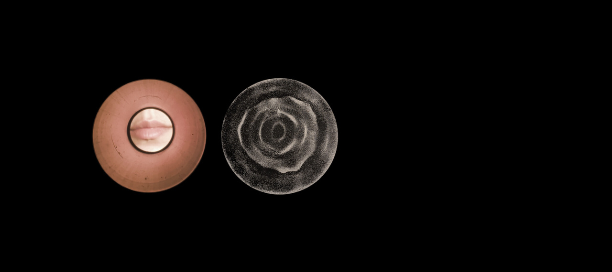
The Reconstruction of the Eidophone
3d Printed Plastic Sound Chamber
Latex Membrane
Rubber Band
Sand, Water

Slide 15
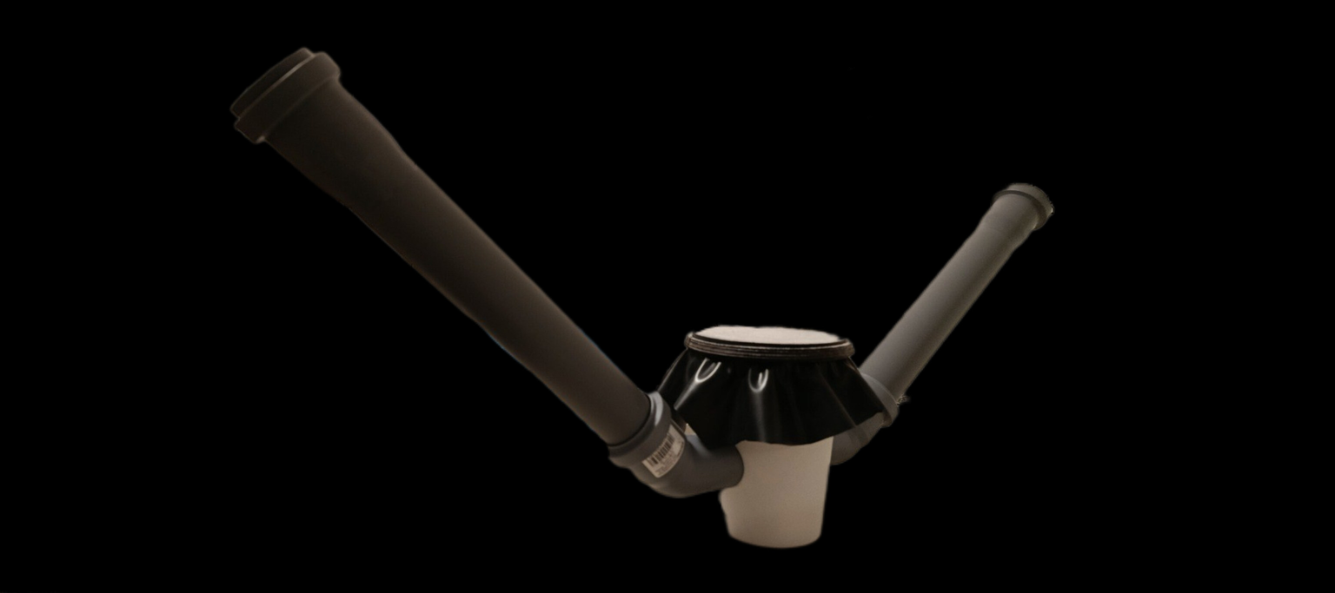

Slide 16
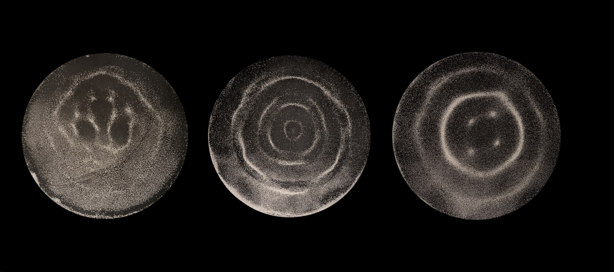

Slide 17
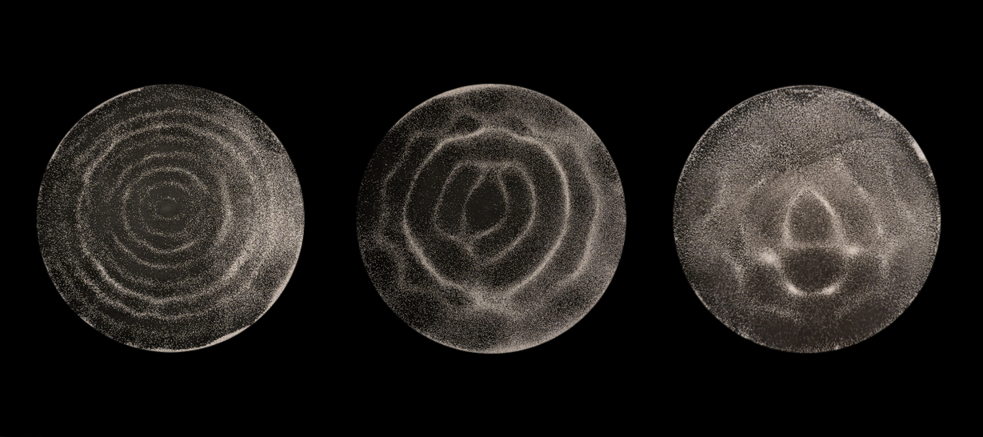

Slide 18
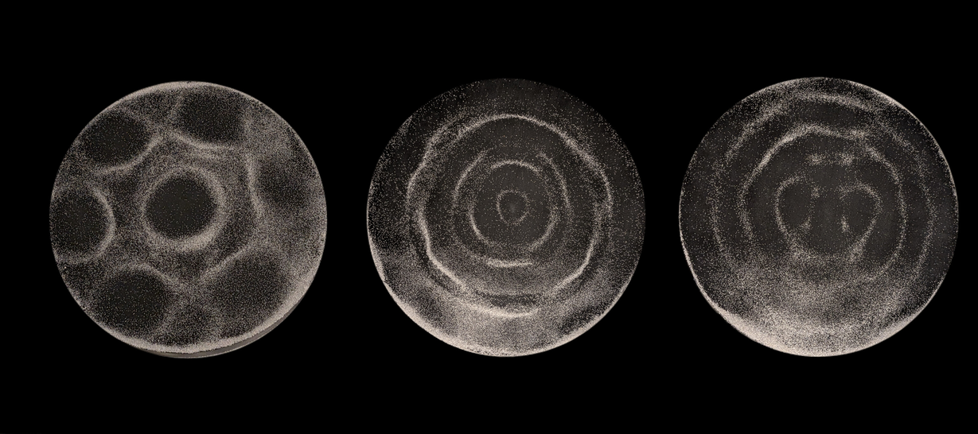

Slide 19
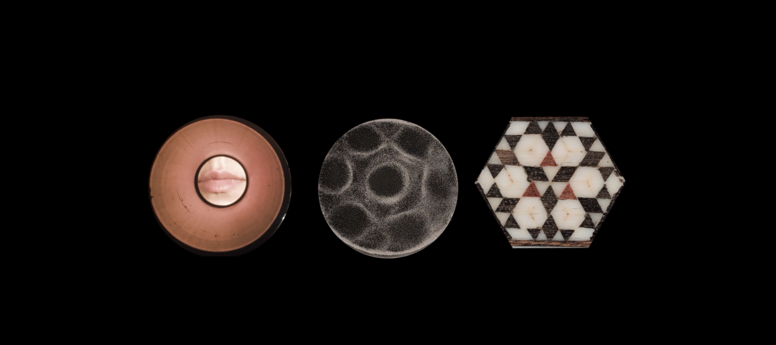

Slide 20
