Slide 1
Performance Art
Helin Özdemir
122519
Media Art Strategies
WiSe 2020/21

Slide 2
Performance Art
Performance art is an artwork or art exhibition created through actions executed by the artist or other participants. It may be live, through documentation, spontaneously or written, presented to a public in a Fine Arts context, traditionally interdisciplinary.[1] Also known as artistic action, it has been developed through the years as a genre of its own in which art is presented live. It had an important and fundamental role in 20th century avant garde art.
It involves four basic elements: time, space, body, and presence of the artist, and the relation between the creator and the public. The actions, generally developed in art galleries and museums, can take place in the street, any kind of setting or space and during any time period.[4] Its goal is to generate a reaction, sometimes with the support of improvisation and a sense of aesthetics. The themes are commonly linked to life experiences of the artist themselves, or the need of denunciation or social criticism and with a spirit of transformation.

Slide 3
Performance Art
Performance art is a form of expression that was born as an alternative artistic manifestation. The discipline emerged in 1916 parallel to dadaism, under the umbrella of conceptual art. The movement was led by Tristan Tzara, one of the pioneers of Dada. Western culture theorists have set the origins of performance art in the beginnings of the 20th century, along with constructivism, Futurism and Dadaism. Dada was an important inspiration because of their poetry actions, which drifted apart from conventionalisms, and futurist artists, specially some members of Russian futurism, could also be identified as part of the starting process of performance art.

Slide 4
Performance Art
MARINA ABRAMOVIĆ AND PERFORMANCE ART
In the early 1970s, when Marina Abramović encountered performance art, she gave up other artistic media. She was inspired by performance artists such as Chris Burden and Hermann Nitsch, who, like her, exposed themselves to hazards or ritual pain to open up their senses. Like body art, her works feature nudity and shock effects.
Abramović created several works together with her then partner, the German artist Ulay, under the collective title of Relation Works. They wrote a manifesto, Art Vital, formulating the guidelines for their joint practice.
The Artist is Present, at the Museum of Modern Art (MoMA) in New York in 2010 is her most famous work to date. Every day from when the museum opened until it closed, and without ever leaving her post, Marina Abramović met the eyes of every new visitor who sat down opposite her. This mutual encounter, which she developed for a few years together with Ulay, was expanded here and presented for a large audience beyond the traditional art scene.

Slide 5
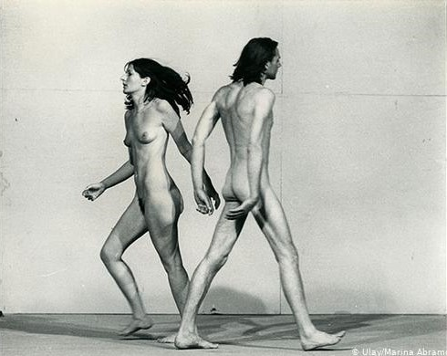
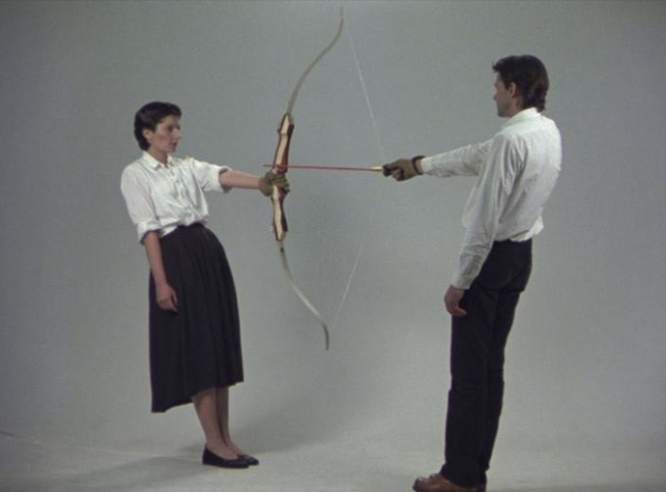
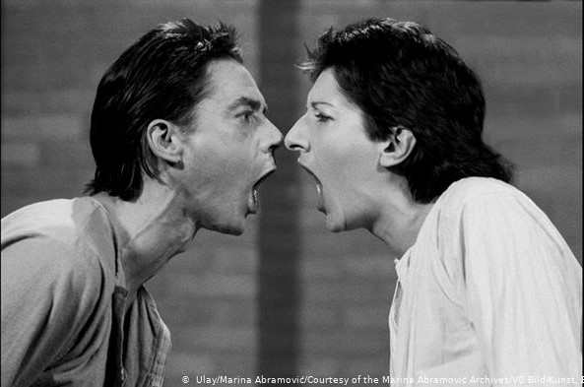
Performance Art
MARINA ABRAMOVIĆ AND PERFORMANCE ART

Slide 6
Dance Performance
Contemporary Dance
Contemporary dance[1] is a genre of dance performance that developed during the mid-twentieth century and has since grown to become one of the dominant genres for formally trained dancers throughout the world, with particularly strong popularity in the U.S. and Europe. Although originally informed by and borrowing from classical, modern, and jazz styles, it has come to incorporate elements from many styles of dance.[2] Due to its technical similarities, it is often perceived to be closely related to modern dance, ballet, and other classical concert dance styles.

Slide 7
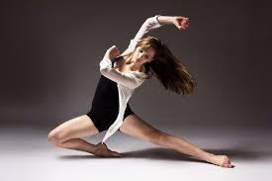
Dance Performance
Contemporary Dance

Slide 8
Dance Performance
Jazz Dance
Jazz dance is a performance dance technique and style that first emerged in the United States in the early twentieth century. Jazz dance may refer to vernacular jazz or to Broadway or theatrical jazz. Both genres build on African-American vernacular styles of dancing that emerged with jazz music. Vernacular jazz dance includes ragtime dances, Charleston, Lindy hop, and mambo. Popular vernacular jazz dance performers include The Whitman Sisters, Florence Mills, Ethel Waters, Al & Leon, Frankie Manning, Norma Miller, Dawn Hampton, and Katherine Dunham. Theatrical jazz dance performed on the concert stage was popularized by Jack Cole, Bob Fosse, Eugene Louis Faccuito, and Gus Giordano.

Slide 9
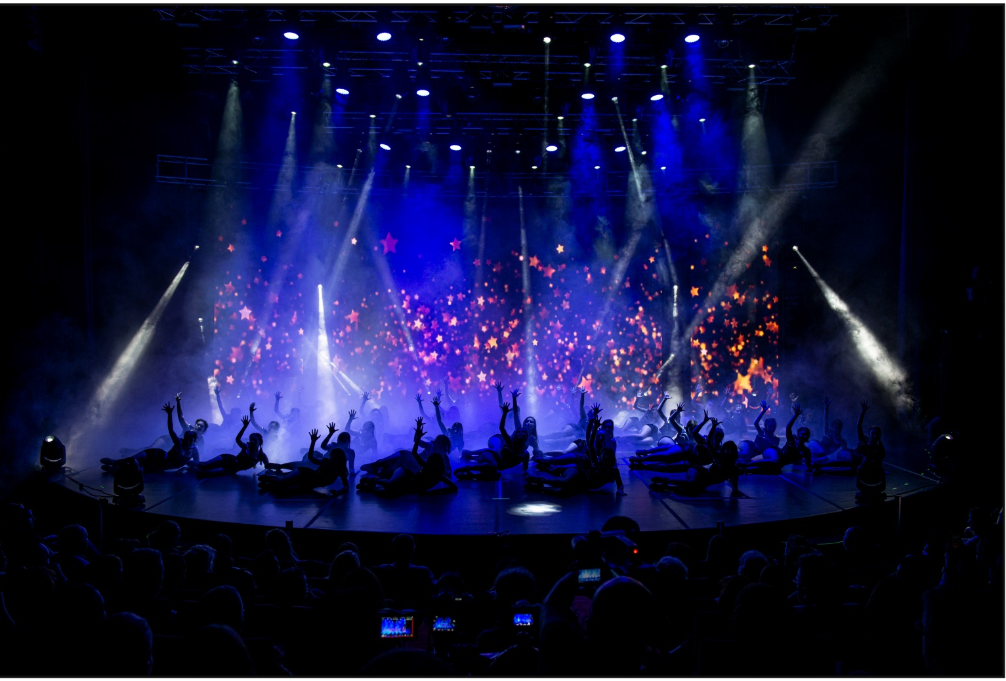
Dance Performance
Jazz Dance

Slide 10
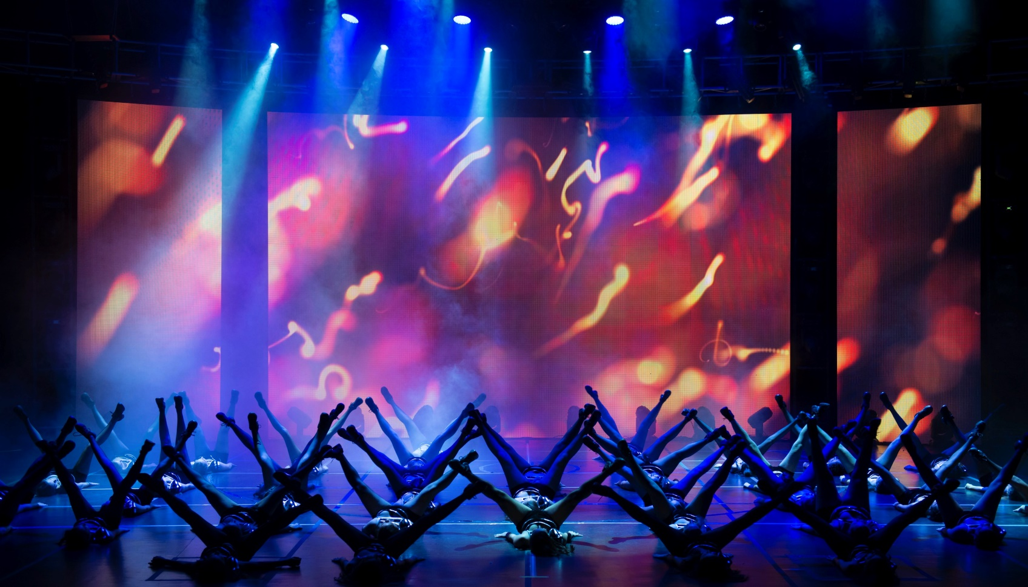
Dance Performance
Jazz Dance

Slide 11
Digital Performance
Digital Performance is a very wide category filled with a range of productions. It is performance that incorporates and integrates computer technologies and techniques. Performers can incorporate multimedia into any type of production whether it is live on a theatre stage or in the street. Anything as small as video recordings or a visual image classifies the production as multimedia. When the key role in a performance is the technologies, it is considered a digital performance. This can be as little as projections on a screen in front of a live audience to creating and devising a performance in an online environment to using animation and sensing software’s.

Slide 12
Digital Performance

Slide 13
About the Project “Solo”
The project will be a dance performance and will be supported using media art tools.
There are two themes considered for performance:
Thema 1 : The female body and its different approaches in dance art
Thema 2 : Different reactions and moods of the body in the self-isolation process

Slide 14
About the Project “Solo”
Stage
The project will be exhibited on the stage and presented to the audience in digital environment. Depending on the course of the coming days, changes may occur in the stage environment.

Slide 15
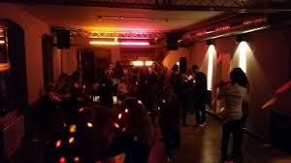
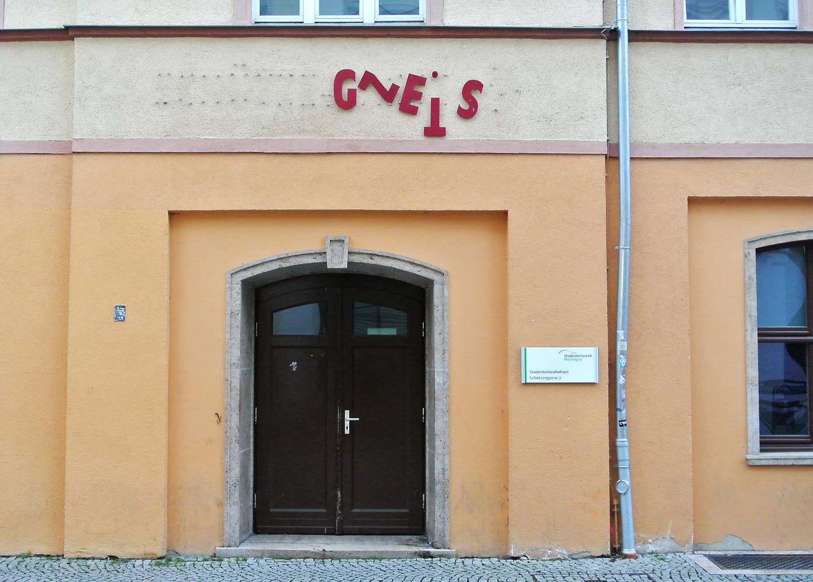
About the Project “Solo”
Estimated performance areas

Slide 16
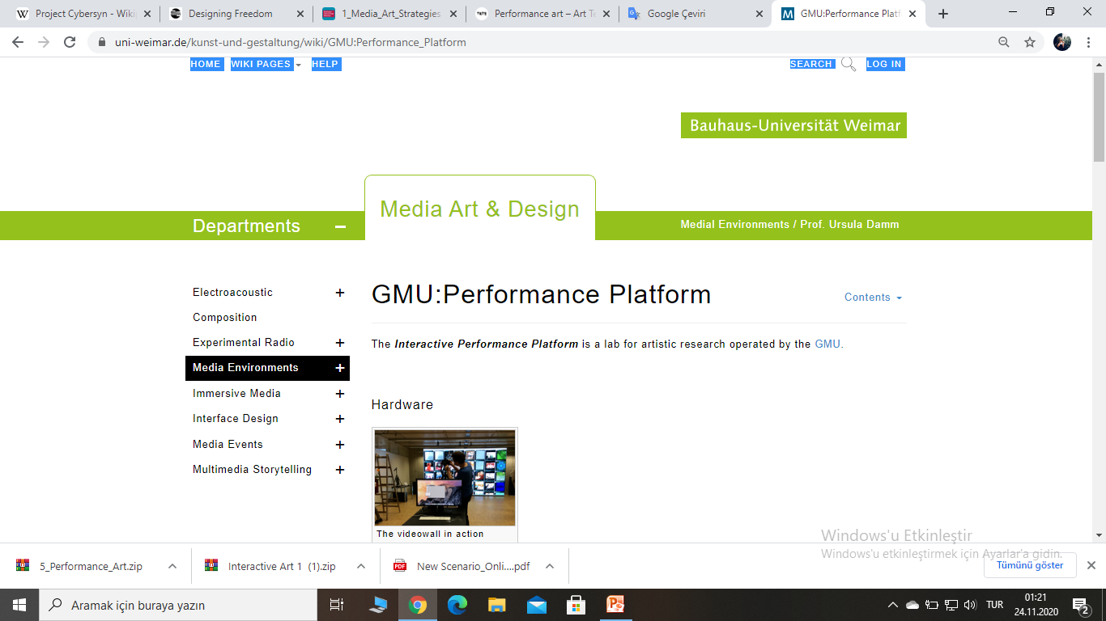
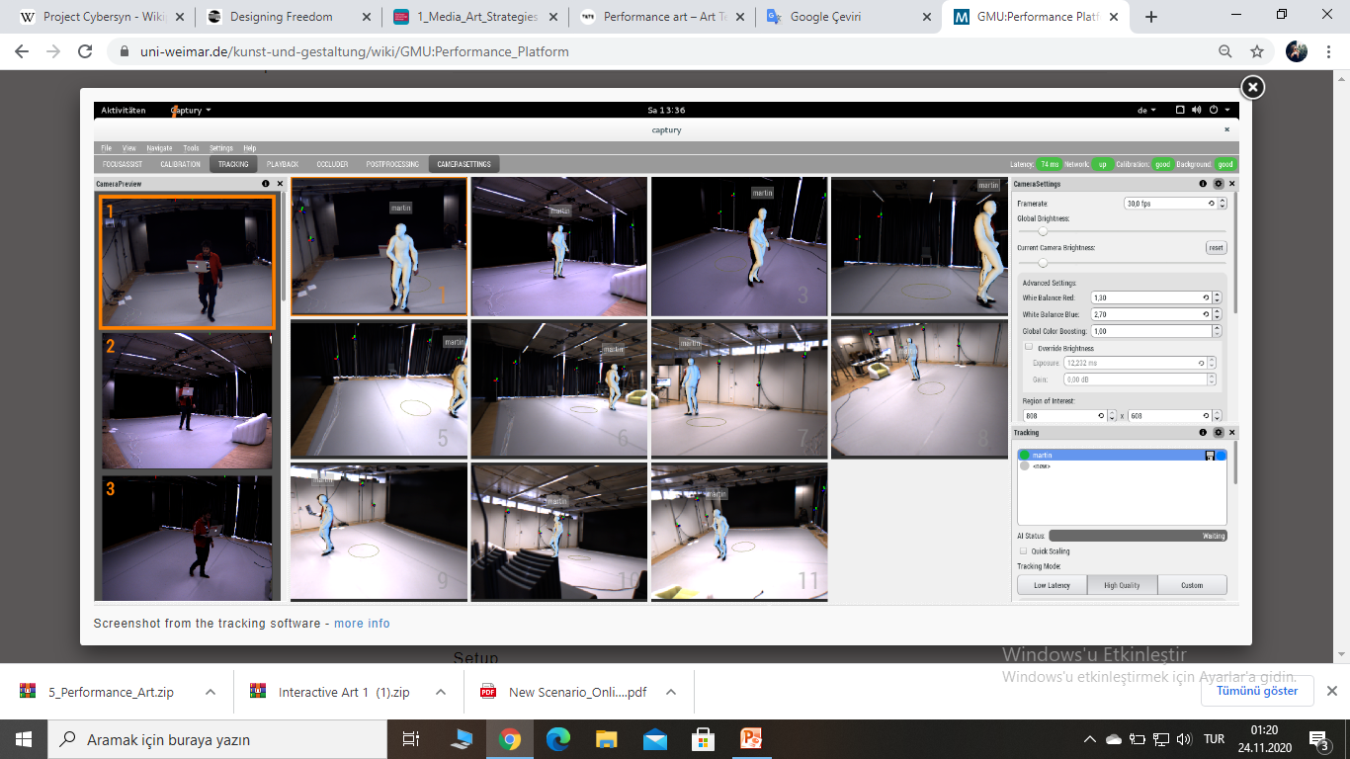
About the Project “Solo”
Estimated performance areas

Slide 17
About the Project “Solo”
References/Material
Digital Performance
A History of New Media in Theater, Dance, Performance Art, and Installation
By Steve Dixon

Slide 18
Sources
https://en.wikipedia.org/wiki/Performance_art
https://en.wikipedia.org/wiki/Contemporary_dance
https://en.wikipedia.org/wiki/Jazz_dance
https://en.wikipedia.org/wiki/Digital_performance
https://www.uni-weimar.de/kunst-und-gestaltung/wiki/GMU:Performance_Platform
https://www.dw.com/en/performance-art-pioneer-ulay-marina-abramovics-former-partner-has-died/a-52612127

