Slide 5


Thank you very much for your attention!
Are there any questions?
Prepared discussion question (optional)

Slide 14

Professur Logo
Logos

Slide 15

Professur Logo
Logos
Construction Engineering and Management

Slide 16

bmi Logo
Logos
BuiltEnvironment-Management-Institute

Slide 17


bmi – bbv Logo
Logos
Professur Baubetrieb und Bauverfahren

Slide 18

Uni Logo
Logos

Slide 19
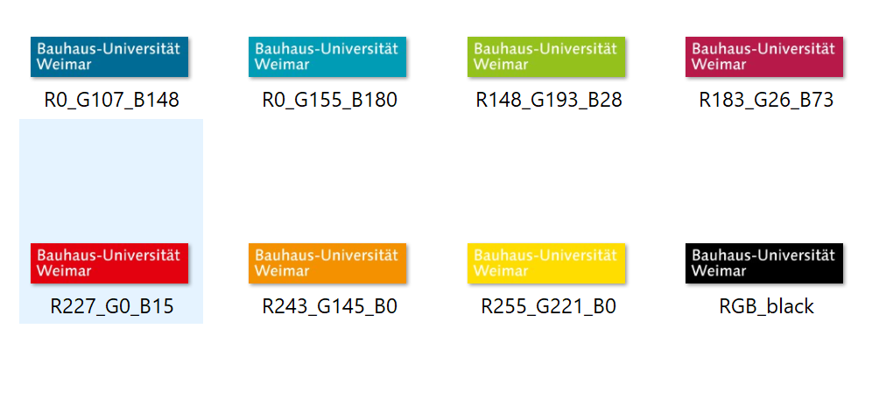
Farbwerte (RGB)
Logos

Slide 20
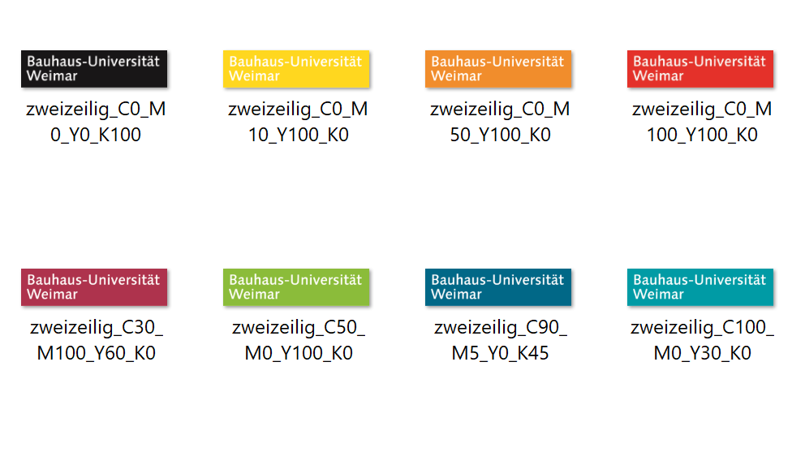
Farbwerte (CMYK)
Logos

