Slide 1
Formatvorlage

Slide 3
Professur Logo
Logos

Slide 4
Professur Logo
Logos
Construction Engineering and Management

Slide 5
bmi Logo
Logos
BuiltEnvironment-Management-Institute

Slide 6
bmi – bbv Logo
Logos
Professur Baubetrieb und Bauverfahren

Slide 7
Uni Logo
Logos

Slide 8
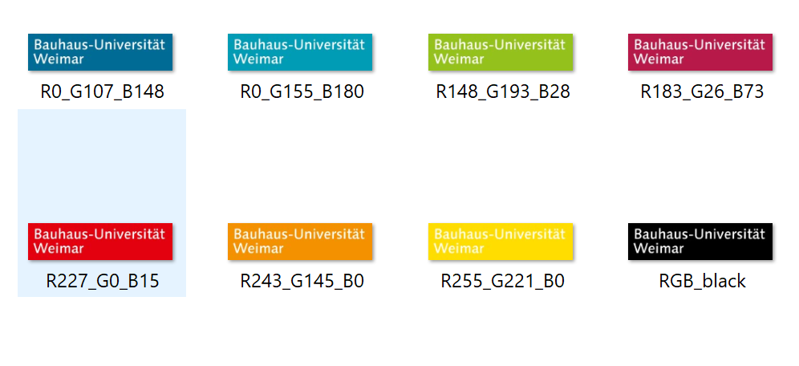
Farbwerte (RGB)
Logos

Slide 9
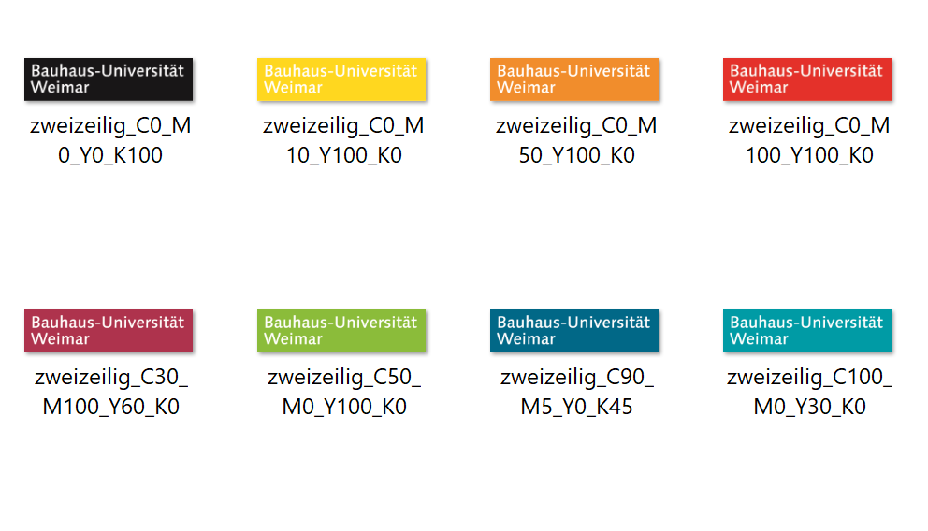
Farbwerte (CMYK)
Logos

